Slide 1
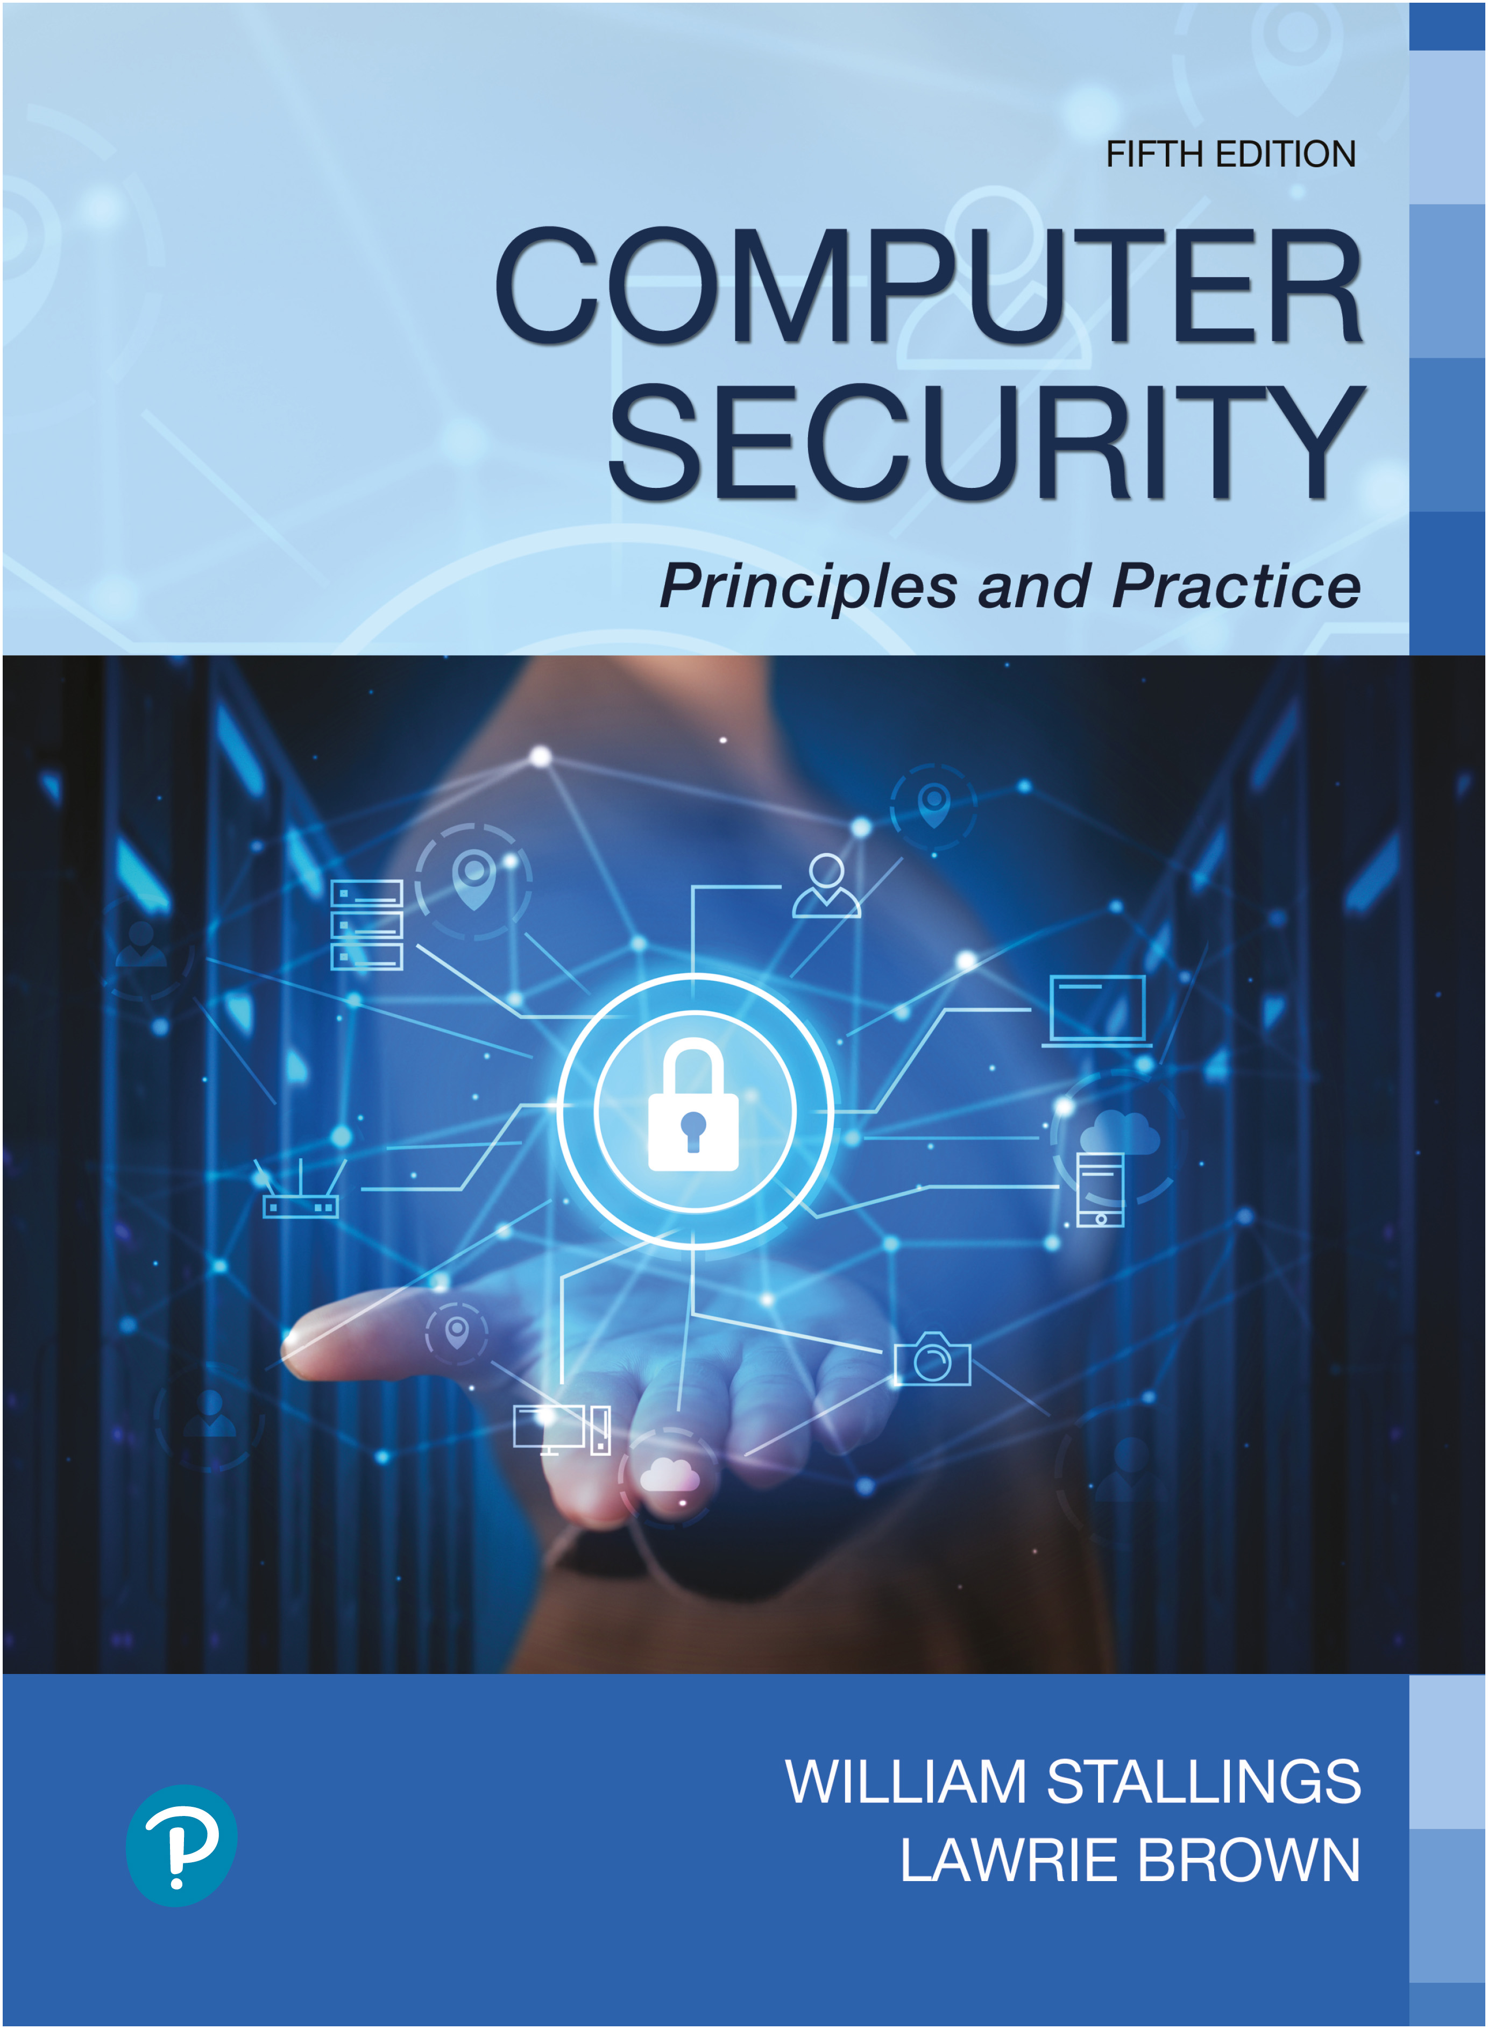

Computer Security: Principles and Practice
Fifth Edition
Chapter 14
I T Security Management and Risk Assessment
Copyright © 2024, 2018, 2015 Pearson Education, Inc. All Rights Reserved
Notes:
If this PowerPoint presentation contains mathematical equations, you may need to check that your computer has the following installed:
1) MathType Plugin
2) Math Player (free versions available)
3) NVDA Reader (free versions available)
In previous chapters, we discussed a range of technical and administrative measures that can be used to manage and improve the security of computer systems and networks. In this chapter and the next, we look at the process of how to best select and implement these measures to effectively address an organization’s security requirements. As we noted in Chapter 1, this involves examining three fundamental questions:
1. What assets do we need to protect?
2. How are those assets threatened?
3. What can we do to counter those threats?

Slide 2
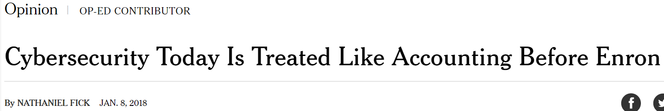


An Opinion Piece
Dept of Justice charged four members of China's military with carrying out a massive hack of Equifax in 2017
One of the largest hacks in history, compromised the data of about 145 million Americans
Sarbanes (D)-Oxley (R) Act (‘02) increased standards for corporate disclosures
Bankruptcy and fraud at huge energy company
Employees lost pensions invested in Enron stock
Arthur Anderson, Enron’s auditor and world’s largest accounting firm, driven out of business
80,000 employees
Other standards:
Health and Human Services Health Insurance Portability and Accountability Act (HIPAA)
Payment Card Industry (PCI) Data Security Standard (DSS)
Other incidents: Worldcom, Tyco
Other i
The Smartest Guys in the Room
SJW

Slide 3
NY State Department of Financial Services Cybersecurity Regulation
A cybersecurity program will adhere to several key requirements, aligned to the NIST Cybersecurity Framework:
Identify all cybersecurity threats, both internal and external
Employ defense infrastructure to protect against those threats
Use a system to detect cybersecurity events
Respond to all detected cybersecurity events
Work to recover from each cybersecurity event
Fulfill various requirements for regulatory reporting
Requires organizations to develop a cybersecurity policy that includes data breach notifications within 72 hours
Must address concerns in alignment with industry best practices and ISO 27001 standards
“ISO/IEC 27001 is the world's best-known standard for information security management systems (ISMS). It defines requirements an ISMS must meet.”
SJW

Slide 4
I T Security Management Overview
Is the formal process of answering the questions:
What assets need to be protected
How are those assets threatened
What can be done to counter those threats
Ensures that critical assets are sufficiently protected in a cost-effective manner
Security risk assessment is needed for each asset in the organization that requires protection
Provides the information necessary to decide what management, operational, and technical controls are needed to reduce the risks – see Table 13.3 and Chapter 15 slide 6
SJW
Notes:
I T security management is the formal process of answering these questions, ensuring that critical assets are sufficiently protected in a cost-effective manner. More specifically, I T security management consists of first determining a clear view of an organization’s I T security objectives and general risk profile. Next, an I T security risk assessment is needed for each asset in the organization that requires protection; this assessment must answer the three key questions listed above. It provides the information necessary to decide what management, operational, and technical controls are needed to either reduce the risks identified to an acceptable level or otherwise accept the resultant risk. This chapter will consider each of these items. The process continues by selecting suitable controls and then writing plans and procedures to ensure these necessary controls are implemented effectively. That implementation must be monitored to determine if the security objectives are met. The whole process must be iterated, and the plans and procedures kept up to date because of the rapid rate of change in both the technology and the risk environment. We discuss the latter part of this process in Chapter 15. The following chapters, then, address specific control areas relating to physical security in Chapter 16, human factors in Chapter 17, and auditing in Chapter 18.

Slide 5
Risk Management Frameworks
Risk Management Framework (NIST)
Integrates risk management activities into the SDLC (Chapter 1 slide 19)
ISO 27005 (International Organization for Standardization)
Standards providing guidelines and techniques for managing information security risks – part of IS0 27000 family
Risk IT / COBIT Framework (ISACA)
Comprehensive review of IT risks and risk management
Operationally Critical Threat, Asset and Vulnerability Evaluation (OCTAVE)
Focus is on assets
Threat Agent Risk Assessment (TARA)
Focus is on threats
SJW

Slide 6
ISO/IEC 27001
Best-known standard (“27k”) for information security management systems (ISMS); defines requirements an ISMS must meet.
Provides companies of any size and from all sectors of activity with guidance for establishing, implementing, maintaining and continually improving an information security management system.
Conformity with ISO/IEC 27001 means that an organization or business has put in place a system to manage risks related to the security of data owned or handled by the company, and that this system respects all the best practices and principles enshrined in this International Standard.
SJW
Notes:
I T security management is the formal process of answering these questions, ensuring that critical assets are sufficiently protected in a cost-effective manner. More specifically, I T security management consists of first determining a clear view of an organization’s I T security objectives and general risk profile. Next, an I T security risk assessment is needed for each asset in the organization that requires protection; this assessment must answer the three key questions listed above. It provides the information necessary to decide what management, operational, and technical controls are needed to either reduce the risks identified to an acceptable level or otherwise accept the resultant risk. This chapter will consider each of these items. The process continues by selecting suitable controls and then writing plans and procedures to ensure these necessary controls are implemented effectively. That implementation must be monitored to determine if the security objectives are met. The whole process must be iterated, and the plans and procedures kept up to date because of the rapid rate of change in both the technology and the risk environment. We discuss the latter part of this process in Chapter 15. The following chapters, then, address specific control areas relating to physical security in Chapter 16, human factors in Chapter 17, and auditing in Chapter 18.

Slide 7
Table 14.1 (1 of 2)
I S O/I E C 27000 Series of Standards on I T Security Techniques
Standards are concerned with best practice
27000:2018 | “Information security management systems—Overview and vocabulary” provides an overview of information security management systems, and defines the vocabulary and definitions used in the 27000 family of standards.
27001:2013 | “Information security management systems—Requirements” specifies the requirements for establishing, implementing, operating, monitoring, reviewing, maintaining, and improving a documented Information Security Management System.
27002:2013 | “Code of practice for information security management” provides guidelines for information security management in an organization and contains a list of best-practice security controls. It was formerly known as I S O17799.
27003:2017 | “Information security management system implementation guidance” details the process from inception to the production of implementation plans of an Information Security Management System specification and design.
27004:2009 | “Information security management—Measurement” provides guidance to help organizations measure and report on the effectiveness of their Information Security Management System processes and controls.
27005:2018 | “Information security risk management” provides guidelines on the information security risk management process. It supersedes I S O13335 to 3 over 4.
The dates shown above are not current; these documents have been updated.
SJW
Notes:
The discipline of IT security management has evolved considerably over the last few decades. This has occurred in response to the rapid growth of and dependence on networked computer systems and the associated rise in risks to these systems. In the last decade, a number of national and international standards have been published. These represent a consensus on the best practice in the field. The International Standards Organization (I S O) has revised and consolidated a number of these standards into the I S O 27000 series. Table 14.1 details a number of key standards within this family, that now consists of more than 40 published to date. In the United States, N I S T has also produced a number of relevant standards, including N I S T SP 800-18 (Guide for Developing Security Plans for Federal Information
Systems, February 2006), N I S T S P 800-30 (Guide for Conducting Risk Assessments, September 2012), and N I S T S P 800-53 (Security and Privacy Controls for Federal
Information Systems and Organizations, September 2020). N I S T also published an updated “Framework for Improving Critical Infrastructure Cybersecurity” in 2018 to
provide guidance to organizations on systematically managing cybersecurity risks. With the growth of concerns about corporate governance following events such as the global financial crisis and repeated incidences of the loss of personal information by government organizations and other businesses, auditors for such organizations increasingly require adherence to formal standards such as these.

Slide 8
Table 14.1 (2 of 2)
I S O/I E C 27000 Series of Standards on I T Security Techniques
Standards are concerned with best practice
27006:2015 | “Requirements for bodies providing audit and certification of information security management systems” specifies requirements and provides guidance for these bodies.
27017:2015 | “Code of practice for Information Security Controls based on I S O/I E C 27002 for Cloud Services” provides guidelines for information security controls applicable to the provision and use of Cloud services.
27033:2010-16 | “Network Security” provides guidance on the design and implementation of network security, in 6 parts.
27034:2011-18 | “Application Security” provides guidance on the framework and process for providing application security, in 8 parts.
27035:2016 | “Information security incident management” provides guidance on the framework and process for providing application security, in 2 parts.
The dates shown above are not current; these documents have been updated.
SJW

Slide 9
Security As A Design Problem
“Providing satisfactory security controls in a computer system is….a system design problem. A combination of hardware, software, communications, physical, personnel and administrative procedural safeguards is required for comprehensive security….software safeguards alone are not sufficient.”
-- The Ware Report Defense Science Board Task Force on Computer Security, 1970
-- See following slides
SJW

Slide 10
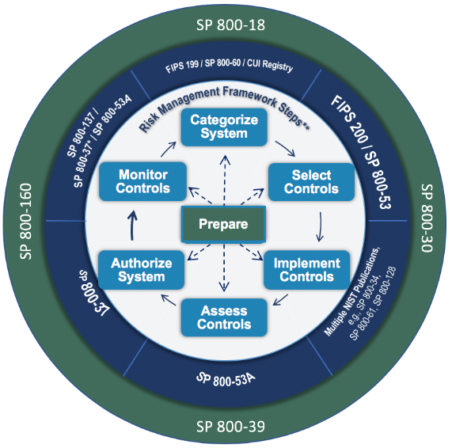
NIST Risk Management Framework (RMF) Overview
A six-step process that integrates security and risk management activities into the system development life cycle (SDLC) by specifying a data security process for new IT systems
System Development Life Cycle (SDLC):
Multistep process that starts with the initiation, analysis, design, and implementation, and continues through the maintenance and disposal of the system (Chapter 1)
SJW
Adapted from NIST

Slide 11
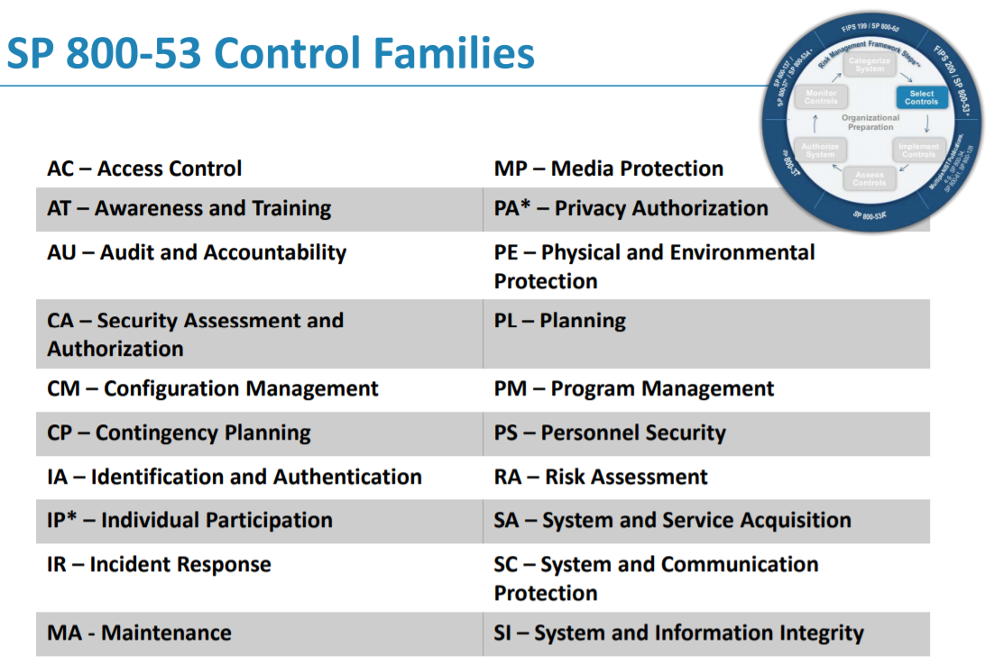
SJW
Adapted from NIST

Slide 12
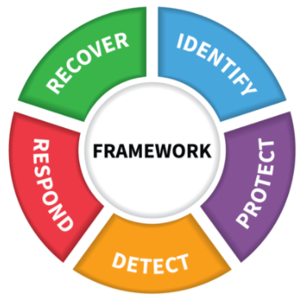
Key NIST Cybersecurity Framework Attributes
Common and accessible language
Adaptable to many technologies, lifecycle phases, sectors and uses
Risk-based
Based on international standards
Living document
Guided by many perspectives – private sector, academia, public sector
Recover
Prevent
Detect
Framework Core
The Framework is guidance, based on existing standards, guidelines, and practices for organizations to better manage and reduce cybersecurity risk.
Designed to foster risk and cybersecurity management communications amongst both internal and external organizational stakeholders.
SJW
Adapted from NIST
Notes:
A framework is a supporting structure.

Slide 13
Framework Core
 | Function | Category | ID
What processes and assets need protection? | Identify | Asset Management | ID.AM
 |  | Business Environment | ID.BE
 |  | Governance | ID.GV
 |  | Risk Assessment | ID.RA
 |  | Risk Management Strategy | ID.RM
 |  | Supply Chain Risk Management | ID.SC
What safeguards are available? | Protect | Identity Management & Access Control | PR.AC
 |  | Awareness and Training | PR.AT
 |  | Data Security | PR.DS
 |  | Information Protection Processes & Procedures | PR.IP
 |  | Maintenance | PR.MA
 |  | Protective Technology | PR.PT
What techniques can identify incidents? | Detect | Anomalies and Events | DE.AE
 |  | Security Continuous Monitoring | DE.CM
 |  | Detection Processes | DE.DP
What techniques can contain impacts of incidents? | Respond | Response Planning | RS.RP
 |  | Communications | RS.CO
 |  | Analysis | RS.AN
 |  | Mitigation | RS.MI
 |  | Improvements | RS.IM
What techniques can restore capabilities? | Recover | Recovery Planning | RC.RP
 |  | Improvements | RC.IM
 |  | Communications | RC.CO
22 categories
Source: NIST: Categories of Cybersecurity Framework PowerPoint
SJW
Notes:
The Framework Core consists of five high level functions: Identify, Protect, Detect, Respond, and Recover (IPDRR)
Next level down is just 22 categories split across the 5 functions.
The Core was designed to cover the entire breadth, while not being overly deep. It covers topics across cyber, physical, and personnel.

Slide 14
Subcategories & Informative References
Function | Category | ID
Identify | Asset Management | ID.AM
 | Business Environment | ID.BE
 | Governance | ID.GV
 | Risk Assessment | ID.RA
 | Risk Management Strategy | ID.RM
 | Supply Chain Risk Management | ID.SC
Protect | Identity Management & Access Control | PR.AC
 | Awareness and Training | PR.AT
 | Data Security | PR.DS
 | Information Protection Processes & Procedures | PR.IP
 | Maintenance | PR.MA
 | Protective Technology | PR.PT
Detect | Anomalies and Events | DE.AE
 | Security Continuous Monitoring | DE.CM
 | Detection Processes | DE.DP
Respond | Response Planning | RS.RP
 | Communications | RS.CO
 | Analysis | RS.AN
 | Mitigation | RS.MI
 | Improvements | RS.IM
Recover | Recovery Planning | RC.RP
 | Improvements | RC.IM
 | Communications | RC.CO
Subcategory | Informative References
ID.BE-1: The organization’s role in the supply chain is identified and communicated | COBIT 5 APO08.04, APO08.05, APO10.03, APO10.04, APO10.05 ISO/IEC 27001:2013 A.15.1.3, A.15.2.1, A.15.2.2 NIST SP 800-53 Rev. 4 CP-2, SA-12
ID.BE-2: The organization’s place in critical infrastructure and its industry sector is identified and communicated | COBIT 5 APO02.06, APO03.01 NIST SP 800-53 Rev. 4 PM-8
ID.BE-3: Priorities for organizational mission, objectives, and activities are established and communicated | COBIT 5 APO02.01, APO02.06, APO03.01 ISA 62443-2-1:2009 4.2.2.1, 4.2.3.6 NIST SP 800-53 Rev. 4 PM-11, SA-14
ID.BE-4: Dependencies and critical functions for delivery of critical services are established | ISO/IEC 27001:2013 A.11.2.2, A.11.2.3, A.12.1.3 NIST SP 800-53 Rev. 4 CP-8, PE-9, PE-11, PM-8, SA-14
ID.BE-5: Resilience requirements to support delivery of critical services are established | COBIT 5 DSS04.02 ISO/IEC 27001:2013 A.11.1.4, A.17.1.1, A.17.1.2, A.17.2.1 NIST SP 800-53 Rev. 4 CP-2, CP-11, SA-14
97 subcategories
Source: NIST: Categories of Cybersecurity Framework PowerPoint
SJW
Notes:
Subcategories are the deepest level of abstraction in the Core. There are 97 subcategories, which are outcome-driven statements that provide considerations for creating or improving a cybersecurity program.
The subcats shown are 5 from Business Environment category.
The other column, is for Informative References. These informative references are broad references that are more technical than the framework itself.
The Framework is designed to be coupled. So, organizations often use these control catalogs such as NIST SP800-53, COBIT, ISO 27001, etc. to obtain more technical guidance.

Slide 15
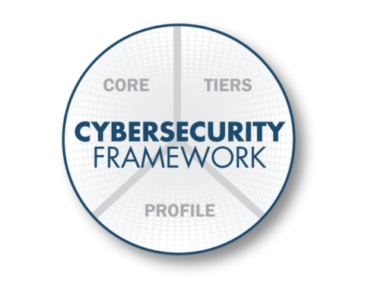
Cybersecurity Framework
Cybersecurity outcomes and informative references
Enables
communication
of cyber risk across
an organization
Four tiers describing how cybersecurity risk is managed by an organization and
degree the risk management
practices
exhibit key characteristics
Some similarity to Capability Maturity Model (CMM) – Chapter 11 slide 23
Aligns industry standards and best practices to the Framework Core in an implementation scenario
Supports prioritization and measurement while factoring in business needs
Source: NIST: Categories of Cybersecurity Framework PowerPoint
SJW
Notes:
Tier 1 – Partial
Risk Management Processes: At Tier 1 organizations, cybersecurity risk management is typically performed in an ad hoc (as necessary)/reactive manner. Furthermore, cybersecurity activities are typically performed with little to no prioritization based on the degree of risk that those activities address.
Integrated Risk Management Program: The lack of processes associated with cyber risk management makes the communication and management of that risk difficult for these organizations. As a result, the organization works with cybersecurity risk management on a case-by-case basis because of the lack of consistent information.
External Participation: These organizations lack a greater understanding of their role in the greater business ecosystem - its position in the supply chain, dependents, and dependencies. Without an understanding of where it sits in the ecosystem, a Tier 1 organization does not share information with third-parties effectively (if at all) and is generally unaware of the supply chain risks that it accepts and passes on to other members of the ecosystem.
Tier 2 - Risk-Informed
Risk Management Processes: Risk management practices, while approved by management, are typically not established as organizational-wide policies within Tier 2 organizations. While risk management practices are not standard, they do directly inform the prioritization of cybersecurity activities alongside organizational risk objectives, the threat environment, and business requirements.
Integrated Risk Management Program: The awareness of cybersecurity risk exists at the organizational level, but it is not standardized organization-wide, and the information around cybersecurity is only shared informally. While some consideration for cybersecurity exists in organizational objectives, it is not standard. A cyber risk assessment may occur, but it is not standard and periodically repeated.
External Participation: Tier 2 organizations understand either their role in the ecosystem in terms of dependencies or dependents, but not both. Organizations like this typically receive information but not share it out, and while they’re aware of the risk associated with their supply chain, they do not typically act on it.
Tier 3 – Repeatable
Risk Management Processes: Tier 3 organizations have formally approved risk management practices, and are expressed as policy. These practices are regularly updated based on changes in business requirements and changing threat landscape.
Integrated Risk Management Program: In this tier, there is an organization-wide approach to managing cybersecurity risk. Risk-informed policies, processes, and procedures are defined and implemented and reviewed. There are methods in place to consistently respond effectively to changes in risk, and personnel possess the knowledge and skills to perform their roles. Senior cybersecurity and business-side executives communication regularly regarding cybersecurity risk.
External Participation: Tier 3 organizations understand their role in the ecosystems and contribute to the broader understanding of risks. They collaborate with other entities regularly that coincide with internally generated information that is shared with other entities. These organizations are aware of the risks associated with their supply chains and act formally on those risks, including implementing written agreements to communicate baseline requirements, governance structures, and policy implementation and monitoring.
Tier 4 – Adaptive
Risk Management Processes: These organizations adapt their cybersecurity practices based on previous and current cybersecurity activities, including lessons learned and predictive factors. They implement a process of continuous improvement - including incorporating advanced cybersecurity technologies and practices, actively adapting to a changing threat and technology landscape.
Integrated Risk Management Program: Building on Tier 3, Tier 4 organizations clearly understand the link between organizational objectives and cybersecurity risk. Senior executives monitor cybersecurity risk in the same context as financial risk and other organizational risks. These organizations base budgeting decisions on an understanding of the current and potential risk environment. Cybersecurity risk is integrated into the organizational culture and evolves from an awareness of previous activities and continuous awareness.
External Participation: Integrating itself further into the ecosystem beyond Tier 3, Tier 4 organizations receive, generate, and contribute to the understanding of the ecosystem around risk. Further integration of sharing information to internal and external stakeholders, the organization uses real-time information to understand and regularly act on supply chain risks. They also have a formalized process integrated into their documentation wit their dependencies and dependents.
Source: https://www.cybersaint.io/blog/the-nist-cybersecurity-framework-implementation-tiers-explained

Slide 16
I T Security Management
I T Security Management: The formal process used to develop and maintain appropriate levels of computer security for an organization’s assets, by preserving their confidentiality, integrity, availability, accountability, authenticity, and reliability. The steps in the I T security management process include
Determining the organization’s I T security objectives, strategies, and policies
Performing an I T security risk assessment that analyzes security threats to I T assets within the organization and determines the resulting risks
Selecting suitable controls to cost effectively protect the organization’s I T assets
Writing plans and procedures to effectively implement the selected controls
Implementing the selected controls, including provision of a security awareness and training program
Monitoring the operation and maintaining the effectiveness of the selected controls
Detecting and reacting to incidents
Chapters 14 - 17
SJW
Notes:
For our purposes, we can define I T security management as follows:
I T SECURITY MANAGEMENT: The formal process used to develop and maintain appropriate levels of computer security for an organization’s assets, by preserving their confidentiality, integrity, availability, accountability, authenticity, and reliability. The steps in the I T security management process include:
• Determining the organization’s I T security objectives, strategies, and policies
• Performing an I T security risk assessment that analyzes security threats to I T assets within the organization and determines the resulting risks
• Selecting suitable controls to cost effectively protect the organization’s I T assets
• Writing plans and procedures to effectively implement the selected controls
• Implementing the selected controls, including provision of a security awareness and training program
• Monitoring the operation and maintaining the effectiveness of the selected controls
• Detecting and reacting to incidents

Slide 17
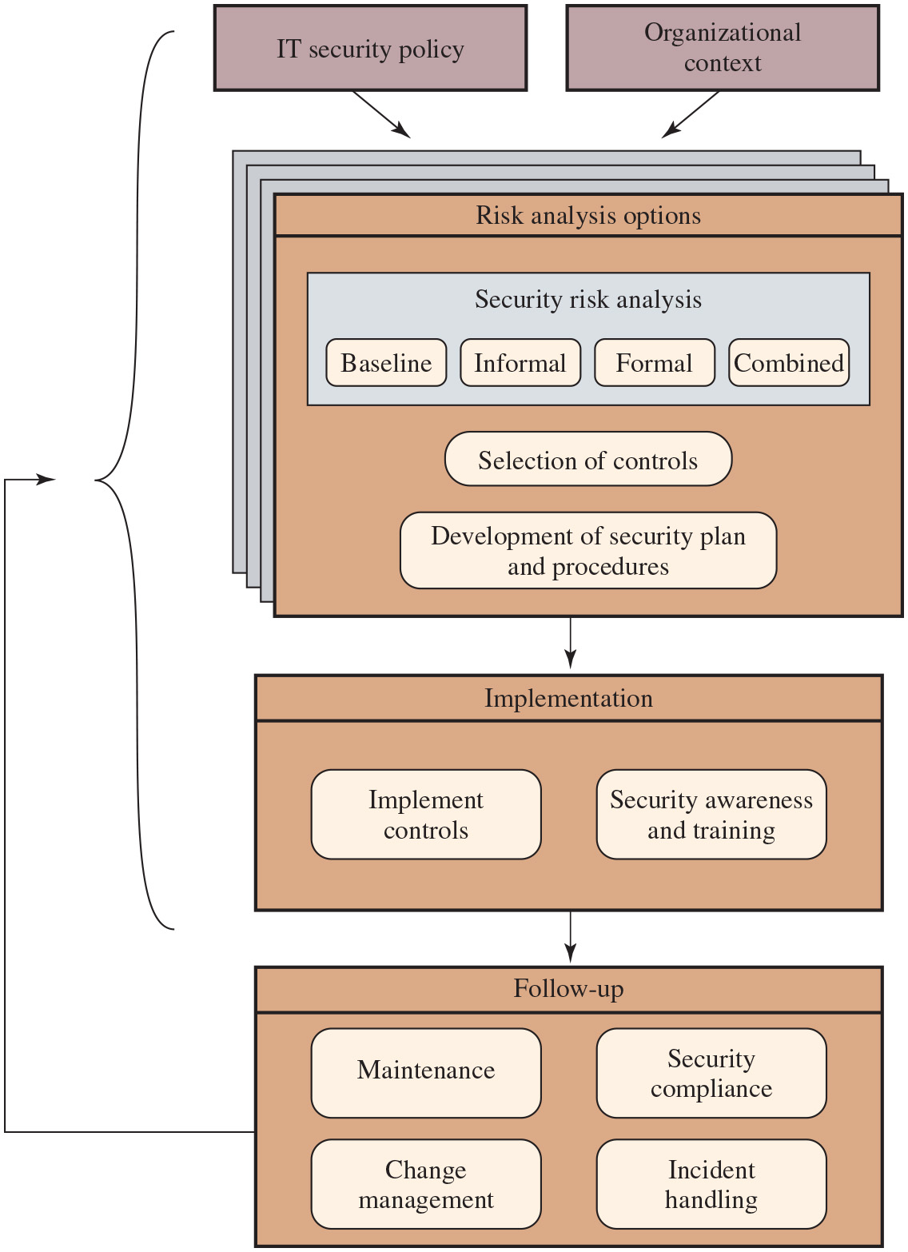
Figure 14.1
Overview of IT Security Management
Should be incorporated into the wider risk assessment of all of the organization’s assets and business processes
This chapter
P
Adapted from ISO27005 Fig. 1 and ISO13335, part 3 Fig. 1
Cyclic process
D
P, D, C, A: Refer to Fig. 14.2
C/A
SJW
Notes:
This process is illustrated in Figure 14.1 (adapted from figure 1 in I S O 27005 (Information security risk management, 2018) and figure 1 in part 3 of I S O 13335 (Management of information and communications technology security, 2004) with a particular focus on the internal details relating to the risk assessment process. I T security management needs to be a key part of an organization’s overall management plan. Similarly, the I T security risk assessment process should be incorporated into the wider risk assessment of all the organization’s assets and business processes. Hence, unless senior management in an organization are aware of and support this process, it is unlikely that the desired security objectives will be met and contribute appropriately to the organization’s business outcomes. Note that I T management is not something undertaken just once. Rather it is a cyclic process that must be repeated constantly in order to keep pace with the rapid changes in both I T technology and the risk environment. Long Description:
The block diagram starts with two rectangular blocks labeled I T security policy and organizational context, which are pointing to the third block. The block is titled risk analysis options and has three sub-blocks labeled security risk analysis, selection of controls, and development of security plan and procedures. The sub-block security risk analysis consists of four other blocks labeled baseline, informal, formal, and combined. The third block is connected to the fourth block titled implementation, which consists of two sub-blocks labeled implement controls and security awareness and training. The fourth block is connected to the fifth block titled follow-up, which consists of four sub-blocks labeled maintenance, security compliance, change management, and incident handling. A curly bracket is drawn including the first four blocks. A forward arrow is drawn from the fifth block to the curly bracket. Note: The third block is shown as a stack.

Slide 18
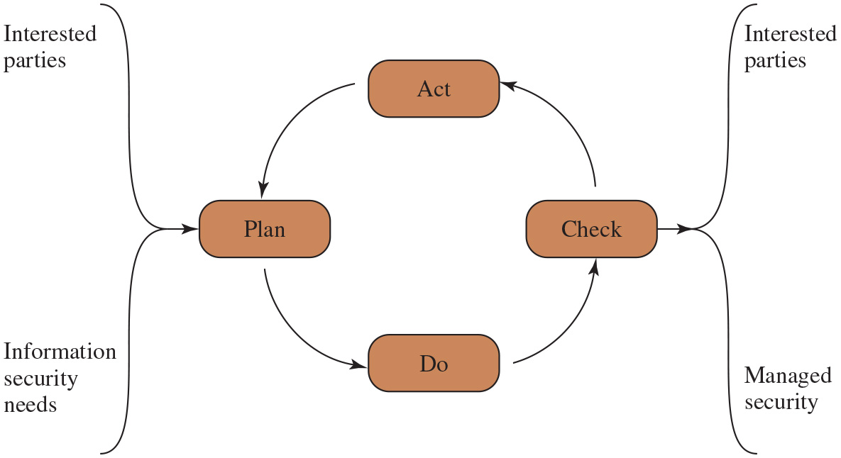
Figure 14.2
The Plan-Do-Check-Act (PDCA) Process Model
With respect to risk treatment plan
PDCA developed by W. Edwards Deming – you may have seen this in a Project Management course. How does this align with Fig. 14.1?
SJW
Notes:
The iterative nature of this process is a key focus of I S O 31000 (Risk management-Principles and guidelines, 2018) and is specifically applied to the security risk management process in I S O 27005. This standard details a model process for managing information security that comprises the following steps:
Plan: Establish security policy, objectives, processes and procedures; perform risk assessment; develop risk treatment plan with appropriate selection of controls or acceptance of risk.
Do: Implement the risk treatment plan.
Check: Monitor and maintain the risk treatment plan.
Act: Maintain and improve the information security risk management process in response to incidents, review, or identified changes.
This process is illustrated in Figure 14.2, which can be aligned with Figure 14.1. The outcome of this process should be that the security needs of the interested parties are managed appropriately. Long Description:
The diagram consists of four blocks labeled plan, do, check, and act arranged in a circular shape, and counterclockwise arrows are drawn between the blocks. Two curved arrows labeled Interested parties and Information security needs point to the plan block. Two curved arrows labeled Interested parties and managed security are drawn from the check block.

Slide 19
Organizational Context and Security Policy
Maintained and updated regularly
Using periodic security reviews
Reflect changing technical/risk environments
To determine objectives, examine role and importance of I T systems in organization
What key tasks, data, decisions, require IT?
Consequences?
Risk profile: the nature and level of the threats faced by an organization
First examine organization’s I T security:
Objectives - wanted I T security outcomes
Strategies - how to meet objectives
Policies - identify what needs to be done
SJW
Notes:
The initial step in the I T security management process comprises an examination of the organization’s I T security objectives, strategies, and policies in the context of the organization’s general risk profile. This can only occur in the context of the wider organizational objectives and policies as part of the management of the organization. Organizational security objectives identify what I T security outcomes should be achieved. They need to address individual rights, legal requirements, and standards imposed on the organization in support of the overall organizational objectives. Organizational security strategies identify how these objectives can be met. Organizational security policies identify what needs to be done. These objectives, strategies, and policies need to be maintained and regularly updated based on the results of periodic security reviews to reflect the constantly changing technological and risk environments.
To help identify these organizational security objectives, the role and importance of the I T systems in the organization is examined. The value of these systems in assisting the organization achieve its goals is reviewed, not just the direct costs of these systems. Questions that help clarify these issues include the following:
• What key aspects of the organization require I T support in order to function efficiently?
• What tasks can only be performed with I T support?
• Which essential decisions depend on the accuracy, currency, integrity, or availability of data managed by the I T systems?
• What data created, managed, processed, and stored by the I T systems need protection?
• What are the consequences to the organization of a security failure in their I T systems?
If the answers to some of the above questions show that I T systems are important to the organization in achieving its goals, then clearly the risks to them should be assessed and appropriate action taken to address any deficiencies identified. A list of key organization security objectives should result from this examination.
Once the objectives are listed, some broad strategy statements can be developed. These outline in general terms how the identified objectives will be met in a consistent manner across the organization. The topics and details in the strategy statements depend on the identified objectives, the size of the organization, and the importance of the I T systems to the organization. The strategy statements should address the approaches the organization will use to manage the security of its I T systems.

Slide 20
Security Policy
Needs to address:
Scope and purpose including relation of objectives to business, legal, regulatory requirements
I T security requirements
Assignment of responsibilities
Risk management approach
Security awareness and training
General personnel issues and any legal sanctions
Integration of security into systems development
Information classification scheme
Contingency and business continuity planning
Incident detection and handling processes
How and when policy reviewed, and change control to it
Notes:
Given the organizational security objectives and strategies, an organizational security policy is developed that describes what the objectives and strategies are and the process used to achieve them. The organizational or corporate security policy may be either a single large document or, more commonly, a set of related documents.
This policy typically needs to address at least the following topics:
• The scope and purpose of the policy
• The relationship of the security objectives to the organization’s legal and regulatory obligations and its business objectives
• I T security requirements in terms of confidentiality, integrity, availability, accountability, authenticity, and reliability particularly with regard to the views of the asset owners
• The assignment of responsibilities relating to the management of I T security and the organizational infrastructure
• The risk management approach adopted by the organization
• How security awareness and training is to be handled
• General personnel issues, especially for those in positions of trust
• Any legal sanctions that may be imposed on staff, and the conditions under which such penalties apply
• Integration of security into systems development and procurement
• Definition of the information classification scheme used across the organization
• Contingency and business continuity planning
• Incident detection and handling processes
• How and when this policy should be reviewed
• The method for controlling changes to this policy
The intent of the policy is to provide a clear overview of how an organization’s I T infrastructure supports its overall business objectives in general, and, more specifically, what security requirements must be provided in order to do this most effectively.

Slide 21
Management Support
I T security policy must be supported by senior management
Need I T security officer (CISO “psy-so”)
To provide consistent overall supervision
Liaison with senior management
Maintenance of I T security objectives, strategies, policies
Handle incidents
Management of I T security awareness and training programs
Interaction with I T project security officers
Large organizations need separate I T project security officers associated with major projects and systems
Manage security policies within their area
Notes:
It is critical that an organization’s I T security policy has full approval and buy-in by senior management. Without this, experience shows that it is unlikely that sufficient resources or emphasis will be given to meeting the identified objectives and achieving a suitable security outcome. With the clear, visible support of senior management, it is much more likely that security will be taken seriously by all levels of personnel in the organization. This support is also evidence of concern and due diligence in the management of the organization’s systems and the monitoring of its risk profile.
Because the responsibility for I T security is shared across the organization, there is a risk of inconsistent implementation of security and a loss of central monitoring and control. The various standards strongly recommend that overall responsibility for the organization’s I T security be assigned to a single person, the organizational I T security officer. This person should ideally have a background in
I T security. The responsibilities of this person include:
• Oversight of the I T security management process.
• Liaison with senior management on I T security issues.
• Maintenance of the organization’s I T security objectives, strategies, and policies.
• Coordination of the response to any I T security incidents.
• Management of the organization-wide I T security awareness and training programs.
• Interaction with I T project security officers.
Larger organizations will need separate I T project security officers associated with major projects and systems. Their role is to develop and maintain security policies for their systems, develop and implement security plans relating to these systems, handle the day-to-day monitoring of the implementation of these plans, and assist with the investigation of incidents involving their systems.

Slide 22
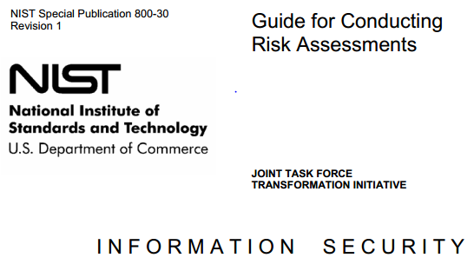
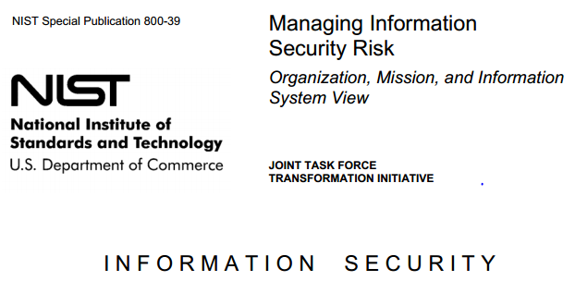
Security Risk Assessment
Critical component of process
Ideally examine every organizational asset
Not feasible in practice
Approaches to identifying and mitigating risks to an organization’s I T infrastructure:
Baseline
Informal
Detailed risk
Combined
CS 395.98 Intro to CyberRisk
Bruce Schneier: “More people are killed every year by pigs than by sharks, which shows you how good we are at evaluating risk”
SJW
Notes:
We now turn to the key risk management component of the I T security process. This stage is critical because without it there is a significant chance that resources will not be deployed where most effective. The result will be that some risks are not addressed, leaving the organization vulnerable, while other safeguards may be deployed without sufficient justification, wasting time and money. Ideally every single organizational asset is examined, and every conceivable risk to it is evaluated. If a risk is judged to be too great, then appropriate remedial controls are deployed to reduce the risk to an acceptable level. In practice this is clearly impossible. The time and effort required, even for large, well-resourced organizations, are clearly neither achievable nor cost effective. Even if possible, the rapid rate of change in both I T technologies and the wider threat environment means that any such assessment would be obsolete as soon as it is completed if not earlier! Clearly some form of compromise evaluation is needed.
Another issue is the decision as to what constitutes an appropriate level of risk to accept. In an ideal world the goal would be to eliminate all risks completely. Again, this is simply not possible. A more realistic alternative is to expend an amount of resources in reducing risks proportional to the potential costs to the organization should that risk occur. This process also must take into consideration the likelihood of the risk’s occurrence. Specifying the acceptable level of risk is simply prudent management and means that resources expended are reasonable in the context of the organization’s available budget, time, and personnel resources. The aim of the risk assessment process is to provide management with the information necessary for them to make reasonable decisions on where available resources will be deployed.
Given the wide range of organizations, from very small businesses to global multinationals and national governments, there clearly needs to be a range of alternatives available in performing this process. There are a range of formal standards that detail suitable I T security risk assessment processes, including I S O 13335, I S O 27005, I S O 31000, and N I S T SP 800-30. In particular, I S O 13335 recognizes four approaches to identifying and mitigating risks to an organization’s I T infrastructure:
• Baseline approach
• Informal approach
• Detailed risk analysis
• Combined approach
The choice among these will be determined by the resources available to the organization and from an initial high-level risk analysis that considers how valuable the I T systems are and how critical to the organization’s business objectives. Legal and regulatory constraints may also require specific approaches. This information should be determined when developing the organization’s I T security objectives, strategies, and policies.

Slide 23
Baseline Approach
Goal is to implement agreed controls to provide protection against the most common threats
Forms a good base for further security measures
Use “industry best practice”
Easy, cheap, can be replicated
Gives no special consideration to variations in risk exposure
May give too much or too little security
Generally recommended only for small organizations without the resources to implement more structured approaches
Notes:
The baseline approach to risk assessment aims to implement a basic general level of security controls on systems using baseline documents, codes of practice and industry best practice. The advantages of this approach are that it doesn’t require the expenditure of additional resources in conducting a more formal risk assessment and that the same measures can be replicated over a range of systems. The major disadvantage is that no special consideration is given to variations in the organization’s risk exposure based on who they are and how their systems are used. In addition, there is a chance that the baseline level may be set either too high, leading to expensive or restrictive security measures that may not be warranted or set too low, resulting in insufficient security and leaving the organization vulnerable.
The goal of the baseline approach is to implement generally agreed controls to provide protection against the most common threats. These would include implementing industry best practice in configuring and deploying systems like those we discuss in Chapter 12 on operating systems security. As such, the baseline approach forms a good base from which further security measures can be determined.
Suitable baseline recommendations and checklists may be obtained from a range of organizations, including:
• Various national and international standards organizations.
• Security-related organizations such as the C E R T, N S A, and so on.
• Industry sector councils or peak groups.
The use of the baseline approach alone would generally be recommended only for small organizations without the resources to implement more structured approaches. But it will at least ensure that a basic level of security is deployed, which is not guaranteed by the default configurations of many systems.

Slide 24
Informal Approach
Involves conducting an informal, pragmatic risk analysis on organization’s I T systems
Exploits knowledge and expertise of analyst
Fairly quick and cheap
Judgments can be made about vulnerabilities and risks that baseline approach would not address
Some risks may be incorrectly assessed
Skewed by analyst’s views, varies over time
Suitable for small to medium sized organizations where I T systems are not necessarily essential
Notes:
The informal approach involves conducting some form of informal, pragmatic risk analysis for the organization’s I T systems. This analysis does not involve the use of a formal, structured process but rather exploits the knowledge and expertise of the individuals performing this analysis. These may either be internal experts if available or, alternatively, external consultants. A major advantage of this approach is that the individuals performing the analysis require no additional skills. Hence, an informal risk assessment can be performed relatively quickly and cheaply. In addition, because the organization’s systems are being examined, judgments can be made about specific vulnerabilities and risks to systems for the organization that the baseline approach would not address. Thus more accurate and targeted controls may be used than would be the case with the baseline approach. There are a number of disadvantages. Because a formal process is not used, there is a chance that some risks may not be considered appropriately, potentially leaving the organization vulnerable. Besides, because the approach is informal, the results may be skewed by the views and prejudices of the individuals performing the analysis. It may also result in insufficient justification for suggested controls, leading to questions over whether the proposed expenditure is really justified. Lastly, there may be inconsistent results over time as a result of differing expertise in those conducting the analysis.
The use of the informal approach would generally be recommended for small to medium-sized organizations where the I T systems are not necessarily essential to meeting the organization’s business objectives and where additional expenditure on risk analysis cannot be justified.

Slide 25
Detailed Risk Analysis
Most comprehensive approach
Assess using formal structured process
Number of stages
Identify threats and vulnerabilities to assets
Identify likelihood of risk occurring and consequences
Significant cost in time, resources, expertise
May be a legal requirement to use
Suitable for large organizations with I T systems critical to their business objectives
Notes:
The third and most comprehensive approach is to conduct a detailed risk assessment of the organization’s I T systems, using a formal structured process. This provides the greatest degree of assurance that all significant risks are identified and their implications considered. This process involves a number of stages, including identification of assets, identification of threats and vulnerabilities to those assets, determination of the likelihood of the risk occurring and the consequences to the organization should that occur, and, hence, the risk the organization is exposed to. With that information, appropriate controls can be chosen and implemented to address the risks identified. The advantages of this approach are that it provides the most detailed examination of the security risks of an organization’s I T system and produces strong justification for expenditure on the controls proposed. It also provides the best information for continuing to manage the security of these systems as they evolve and change. The major disadvantage is the significant cost in time, resources, and expertise needed to perform such an analysis. The time taken to perform this analysis may also result in delays in providing suitable levels of protection for some systems. The details of this approach are discussed in the next section.
The use of a formal, detailed risk analysis is often a legal requirement for some government organizations and businesses providing key services to them. This may also be the case for organizations providing key national infrastructure. For such organizations, there is no choice but to use this approach. It may also be the approach of choice for large organizations with I T systems critical to their business objectives and with the resources available to perform this type of analysis.

Slide 26
Detailed Security Risk Analysis
Provides the most accurate evaluation of an organization's I T system’s security risks
Highest cost
Initially focused on addressing defense security concerns
Often mandated by government organizations and associated businesses
Notes:
The formal, detailed security risk analysis approach provides the most accurate evaluation of an organization’s I T system’s security risks, but at the highest cost. This approach has evolved with the development of trusted computer systems, initially focused on addressing defense security concerns as we discussed in Chapter 12. The original security risk assessment methodology was given in the Yellow Book standard (C S C-S T D-004-85 June 1985), one of the original U.S. T C S E C rainbow book series of standards. Its focus was entirely on protecting the confidentiality of information, reflecting the military concern with information classification. The recommended rating it gave for a trusted computer system depended on difference between the minimum user clearance and the maximum information classification. Specifically it defined a risk index as
Risk Index = Max Info Sensitivity - Min User Clearance.
A table in this standard, listing suitable categories of systems for each risk level, was used to select the system type. Clearly this limited approach neither adequately reflects the range of security services required nor the wide range of possible threats. Over the years since, the process of conducting a security risk assessment that does consider these issues has evolved.

Slide 27
Combined Approach
Combines elements of the baseline, informal, and detailed risk analysis approaches
Aim is to provide reasonable levels of protection as quickly as possible, then to examine and adjust the protection controls deployed on key systems over time
Approach starts with the implementation of suitable baseline security recommendations on all systems
Next, systems either exposed to high risk levels or critical to the organization's business objectives are identified in the high-level risk assessment
A decision can then be made to possibly conduct an immediate informal risk assessment on key systems with the aim of relatively quickly tailoring controls to more accurately reflect their requirements
Lastly, an ordered process of performing detailed risk analyses of these systems can be instituted
Over time, this can result in the most appropriate and cost-effective security controls being selected and implemented on these systems
Notes:
The last approach combines elements of the baseline, informal, and detailed risk analysis approaches. The aim is to provide reasonable levels of protection as quickly as possible, then to examine and adjust the protection controls deployed on key systems over time. The approach starts with the implementation of suitable baseline security recommendations on all systems. Next, systems either exposed to high risk levels or critical to the organization’s business objectives are identified in the high-level risk assessment. A decision can then be made to possibly conduct an immediate informal risk assessment on key systems with the aim of relatively quickly tailoring controls to more accurately reflect their requirements. Lastly, an ordered process of performing detailed risk analyses of these systems can be instituted. Over time this can result in the most appropriate and cost-effective security controls being selected and implemented on these systems. This approach has a significant number of advantages. The use of the initial high-level analysis to determine where further resources need to be expended, rather than facing a full detailed risk analysis of all systems, may well be easier to sell to management. It also results in the development of a strategic picture of the I T resources and where major risks are likely to occur. This provides a key planning aid in the subsequent management of the organization’s security. The use of the baseline and informal analyses ensures that a basic level of security protection is implemented early. And it means that resources are likely to be applied where most needed and that systems most at risk are likely to be examined further reasonably early in the process. However, there are some disadvantages. If the initial high-level analysis is inaccurate, then some systems for which a detailed risk analysis should be performed may remain vulnerable for some time. Nonetheless, the use of the baseline approach should ensure a basic minimum security level on such systems. Further, if the results of the high-level analysis are reviewed appropriately, the chance of lingering vulnerability is minimized.
I S O 13335 considers that for most organizations, in most circumstances, this approach is the most cost effective. Consequently its use is highly recommended.

Slide 28
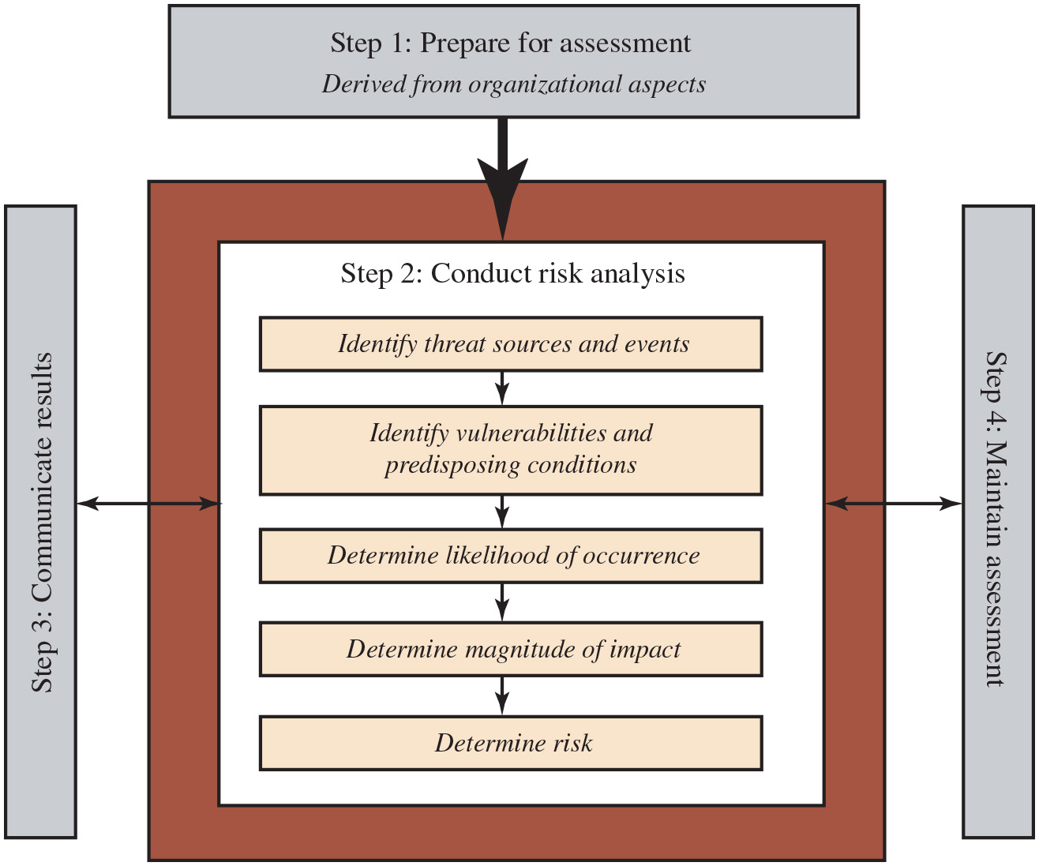
Figure 14.3
Risk Assessment Process
Source: Guide for Conducting Risk Assessments NIST SP 800-30
SJW
Notes:
A number of national and international standards document the expected formal risk analysis approach. These include I S O 27005, ISO 31000, N I S T S P 800-30, and [S A S N13]. This approach is often mandated by government organizations and associated businesses. These standards all broadly agree on the process used. Figure 14.3 (reproduced from figure 5 in N I S T S P 800-30) illustrates a typical process used.
Long Description:
The block diagram consists of four steps. Steps 1, 3, and 4 are shown in rectangular blocks. Step 2 is shown inside a rectangular frame. Step 1: Prepare for assessment, derived from organizational aspects. Step 2: Conduct risk analysis. Step 3: Communicate results. Step 4: Maintain assessment. Step 2 consists of another block diagram with five rectangular blocks connected using downward arrows from top to bottom are given as follow: Identify threat sources and events, identify vulnerabilities and predisposing conditions, determine likelihood of occurrence, determine magnitude of impact, and determine risk. Step 1 is connected to step 2 using a downward arrow. A double headed arrow is drawn between steps 2 and 3. A double headed arrow is drawn between steps 2 and 4.

Slide 29
Establishing the Context
Initial step
Determine the basic parameters of the risk assessment
Identify the assets to be examined
Explores political and social environment in which the organization operates
Legal and regulatory constraints
Legal and regulatory example: Sarbanes-Oxley (SOX) Act of 2002 response to Enron, Worldcom and Tyco accounting scandals
Provide baseline for organization’s risk exposure
Risk appetite
The level of risk the organization views as acceptable
SJW
Notes:
The initial step is known as establishing the context or system characterization. Its purpose is to determine the basic parameters within which the risk assessment will be conducted and then to identify the assets to be examined.
The process starts with the organizational security objectives and considers the broad risk exposure of the organization. This recognizes that not all organizations are equally at risk, but that some, because of their function, may be specifically targeted. It explores the relationship between a specific organization and the wider political and social environment in which it operates.
Industries such as agriculture and education are considered to be at lesser risk compared to government or banking and finance. Note that this classification predates the September 11, 2001, terrorist attacks, and it is likely that there has been change since it was developed. In particular it is likely that utilities, for example, are probably at higher risk than the classification suggests. N I S T has indicated that the following industries are vulnerable to risks in Supervisory Control and Data
Acquisition (S C A D A) and process control systems: electric, water and wastewater, oil and natural gas, chemical, pharmaceutical, pulp and paper, food and beverage, discrete manufacturing (automotive, aerospace, and durable goods), air and rail transportation, and mining and metallurgy.
At this point in determining an organization’s broad risk exposure, any relevant legal and regulatory constraints must also be identified. These features provide a baseline for the organization’s risk exposure and an initial indication of the broad scale of resources it needs to expend to manage this risk in order to successfully conduct business.
Next, senior management must define the organization’s risk appetite, the level of risk the organization views as acceptable. Again this will depend very much on the type of organization, and its management’s attitude to how it conducts business. For example, banking and finance organizations tend to be fairly conservative and risk averse. This means they want a low residual risk and are willing to spend the resources necessary to achieve this. In contrast, a leading-edge manufacturer with a new product may have a much greater risk tolerance. The manufacturer is willing to take a chance to obtain a competitive advantage and, with limited resources, wishes to expend less on risk controls. This decision is not just I T specific. Rather it reflects the organization’s broader management approach to how it conducts business.

Slide 30
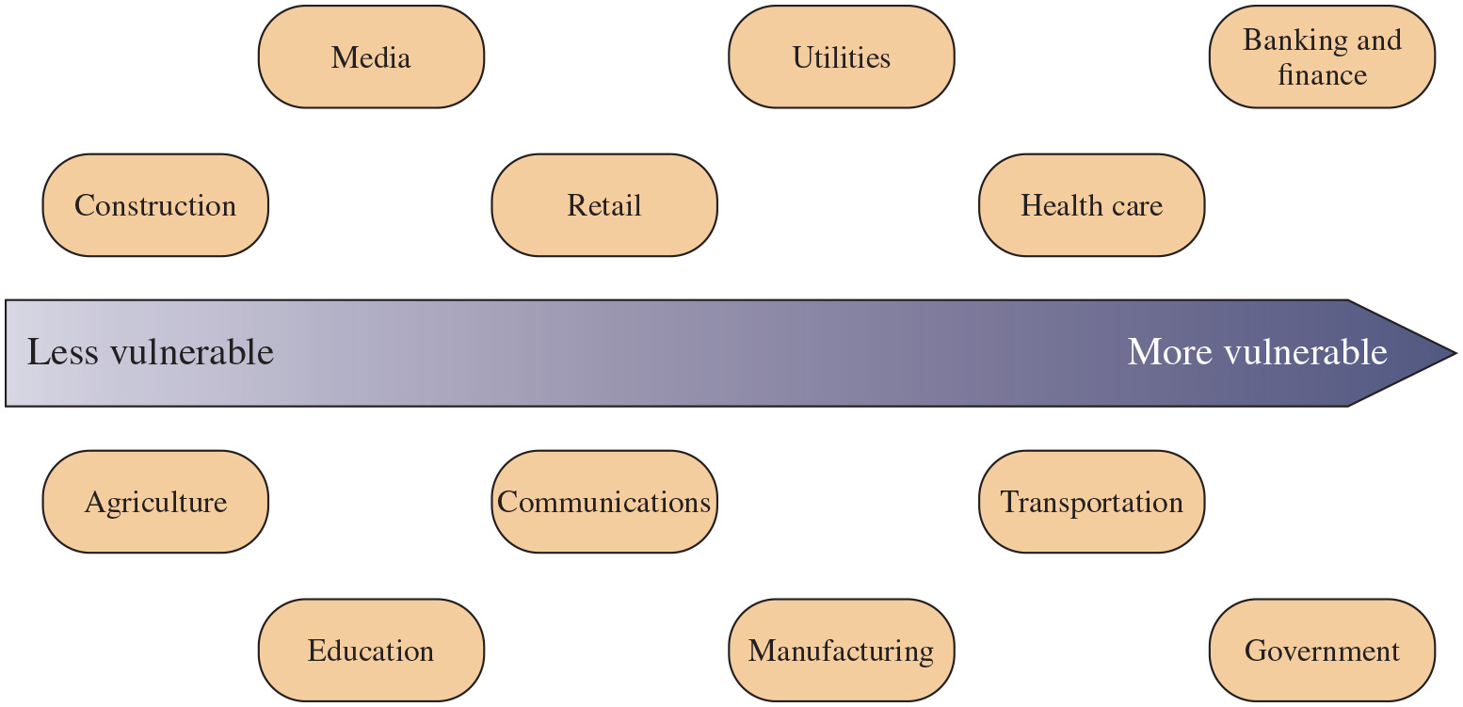
Figure 14.4
Generic Organizational Risk Context
Notes:
Figure 14.4 (adapted from an I D C 2000 report) suggests a possible spectrum of organizational risk. Long Description:
The diagram consists of a horizontal double arrow pointing toward the right and 12 blocks arranged above and below the double arrow. The right end of the double arrow is labeled more vulnerable and the left end is labeled less vulnerable. The six blocks above the double arrow are given as follows: construction, media, retail, utilities, health care, and banking and finance. The six blocks below the double arrow are given as follows: agriculture, education, communications, manufacturing, transportation, and government.

Slide 31
Asset Identification
Last component is to identify assets to examine
Draw on expertise of people in relevant areas of organization to identify key assets
Identify and interview such personnel
Asset
“anything that needs to be protected” because it has value to the organization and contributes to the successful attainment of the organization’s objectives
Assets may be tangible or intangible
SJW
Notes:
The last component of this first step in the risk assessment is to identify the assets to examine. This directly addresses the first of the three fundamental questions we opened this chapter with: “What assets do we need to protect?” An asset is “anything that needs to be protected” because it has value to the organization and contributes to the successful attainment of the organization’s objectives. As we discuss in Chapter 1, an asset may be either tangible or intangible. It includes computer and communications hardware infrastructure, software (including applications and information/data held on these systems), the documentation on these systems, and the people who manage and maintain these systems. Within the boundaries identified for the risk assessment, these assets need to be identified and their value to the organization assessed. It is important to emphasize again that while the ideal is to consider every conceivable asset, in practice this is not possible. Rather the goal here is to identify all assets that contribute significantly to attaining the organization’s objectives and whose compromise or loss would seriously impact on the organization’s operation. [S A S N 13] describes this process as a criticality assessment that aims to identify those assets that are most important to the organization.
While the risk assessment process is most likely being managed by security experts, they will not necessarily have a high degree of familiarity with the organization’s operation and structures. Thus they need to draw on the expertise of the people in the relevant areas of the organization to identify key assets and their value to the organization. A key element of this process step is identifying and interviewing such personnel. Many of the standards listed previously include checklists of types of assets and suggestions for mechanisms for gathering the necessary information. These should be consulted and used. The outcome of this step should be a list of assets with brief descriptions of their use by, and value to, the organization.

Slide 32
Terminology
Asset:
A system resource or capability of value to its owner that requires protection.
Threat:
A potential for a threat source to exploit a vulnerability in some asset, which if it occurs may compromise the security of the asset and cause harm to the asset’s owner.
Vulnerability:
A flaw or weakness in an asset’s design, implementation, or operation and management that could be exploited by some threat.
The potential for loss computed as the combination of the likelihood that a given threat exploits some vulnerability to an asset and the magnitude of harmful consequence that results to the asset’s owner.
Also, inherent risk and target risk
Risk:
“Threat” and “risk” are often used interchangeably; there are conflicting definitions for these terms
SJW
Notes:
The next step in the process is to identify the threats or risks the assets are exposed to. This directly addresses the second of our three fundamental questions: “How are those assets threatened?” It is worth commenting on the terminology used here. The terms threat and risk, while having distinct meanings, are often used interchangeably in this context. There is considerable variation in the definitions of these terms, as seen in the range of definitions provided in the cited standards. The following definitions will be useful in our discussion:
The relationship among these and other security concepts is illustrated in Figure 1.2.
The goal of this stage is to identify potentially significant risks to the assets listed. This requires answering the following questions for each asset:
1. Who or what could cause it harm?
2. How could this occur?

Slide 33
Threat Identification
A threat is:
Anything that might hinder or prevent an asset from providing appropriate levels of the key security services
Integrity
Availability
Accountability
Authenticity
Reliability
Confidentiality
Notes:
Answering the first of these questions involves identifying potential threats to assets. In the broadest sense, a threat is anything that might hinder or prevent an asset from providing appropriate levels of the key security services: confidentiality, integrity, availability, accountability, authenticity, and reliability. Note that one asset may have multiple threats, and a single threat may target multiple assets.

Slide 34
Threat Sources
Threats may be
Natural “acts of God”
Man-made
Accidental or deliberate
Evaluation of human threat sources should consider:
Motivation
Capability
Resources
Probability of attack
Deterrence
Any previous experience of attacks seen by the organization also needs to be considered
Who and what causes a threat to an asset?
Many publications listing threats
SJW
Notes:
A threat may be either natural or human-made and may be accidental or deliberate. This is known as the threat source or threat agent. The classic natural threat sources are those often referred to as acts of God and include damage caused by fire, flood, storm, earthquake, and other such natural events. It also includes environmental threats such as long-term loss of power or natural gas. Or it may be the result of chemical contamination or leakage. Alternatively, a threat source may be a human agent acting either directly or indirectly. Examples of the former include an insider retrieving and selling information for personal gain or a hacker targeting the organization’s server over the Internet. An example of the latter includes someone writing and releasing a network worm that infects the organization’s systems. These examples all involved a deliberate exploit of a threat. However, a threat may also be a result of an accident, such as an employee incorrectly entering information on a system, which results in the system malfunctioning.
Identifying possible threats and threat sources requires the use of a variety of sources along with the experience of the risk assessor. The chance of natural threats occurring in any particular area is usually well known from insurance statistics. Lists of other potential threats may be found in the standards, in the results of I T security surveys, and in information from government security agencies. The annual computer crime reports, such as those by C S I/F B I and by Verizon in the United States and similar reports in other countries, provide useful general guidance on the broad I T threat environment and the most common problem areas. Standards, such as N I S T S P 800-30 Appendix D with a taxonomy of threat sources and Appendix E with examples of threats, may also assist here.
However, this general guidance needs to be tailored to the organization and the risk environment it operates in. This involves consideration of vulnerabilities in the organization’s I T systems, which may indicate that some risks are either more or less likely than the general case. Where an organization’s security concerns are sufficiently high that threats need to be specifically identified, threat scenarios can be modelled, developed, and analyzed as described in N I S T S P 800-30. Organization’s define threat scenarios to describe how the tactics, techniques, and procedures employed by an attacker can contribute to or cause harm. The possible motivation of deliberate attackers in relation to the organization should be considered as potentially influencing this variation in risk. In addition, any previous experience of attacks seen by the organization needs to be considered as that is concrete evidence of risks that are known to occur. When evaluating possible human threat sources, it is worth considering their reason and capabilities for attacking this organization, including their:
• Motivation: Why would they target this organization; how motivated are they?
• Capability: What is their level of skill in exploiting the threat?
• Resources: How much time, money, and other resources could they deploy?
• Probability of attack: How likely and how often would your assets be targeted?
• Deterrence: What are the consequences to the attacker of being identified?

Slide 35
Vulnerability Identification
Identify exploitable flaws or weaknesses in organization’s I T systems or processes
Determines applicability and significance of threat to organization
Need combination of threat and vulnerability to create a risk to an asset
Outcome should be a list of threats and vulnerabilities with brief descriptions of how and why they might occur
Notes:
Answering the second of these questions, “How could this occur?” involves identifying flaws or weaknesses in the organization’s I T systems or processes that could be exploited by a threat. This will help determine the applicability of the threat to the organization and its significance. Note that the mere existence of some vulnerability does not mean harm will be caused to an asset. There must also be a threat source for some threat that can exploit the vulnerability for harm. It is the combination of a threat and a vulnerability that creates a risk to an asset.
Again, many of the standards listed previously include checklists of threats and vulnerabilities and suggestions for tools and techniques to list them and to determine their relevance to the organization. The outcome of this step should be a list of threats and vulnerabilities, with brief descriptions of how and why they might occur.

Slide 36
Analyze Risks
Specify likelihood of occurrence of each identified threat to asset given existing controls
Specify consequence should threat occur
Derive overall risk rating for each threat
Hard to determine accurate probabilities and realistic cost consequences
Use qualitative, not quantitative, ratings
Notes:
Having identified key assets and the likely threats and vulnerabilities they are exposed to, the next step is to determine the level of risk each of these poses to the organization. The aim is to identify and categorize the risks to assets that threaten the regular operations of the organization. Risk analysis also provides information to management to help managers evaluate these risks and determine how best to treat them. Risk analysis involves first specifying the likelihood of occurrence of each identified threat to an asset in the context of any existing controls. Next, the consequence to the organization is determined should that threat eventuate. Lastly, this information is combined to derive an overall risk rating for each threat. The ideal would be to specify the likelihood as a probability value and the consequence as a monetary cost to the organization should it occur. The resulting risk is then simply given as
Risk = (Probability that threat occurs) x (Cost to organization).
This can be directly equated to the value the threatened asset has for the organization, and, hence, specify what level of expenditure is reasonable to reduce the probability of its occurrence to an acceptable level. Unfortunately, it is often extremely hard to determine accurate probabilities, realistic cost consequences, or both. This is particularly true of intangible assets, such as the loss of confidentiality of a trade secret. Hence, most risk analyses use qualitative, rather than quantitative, ratings for both these items. The goal is then to order the resulting risks to help determine which need to be most urgently treated, rather than to give them an absolute value.

Slide 37
Analyze Risks
Simple model: Risk = P X V
P = probability of risk event
V = value lost by risk event
Extended model: Risk = P_{a} X P_{s} X V
P_{a} = probability of attack
P_{s} = probability of success
V = value lost by risk event
Whitman’s model: Risk = P X V (1 – CC + UK)
P = probability that a vulnerability is exploited
V = value of asset
CC = fraction of asset mitigated by current control
UK = fraction of risk not fully known (uncertainity)
Most common model: Risk = T X V x I
T = likelihood of threat
V = vulnerability level
I = impact of successful exploitation of vulnerability
Key challenges:
Identification of high-value information assets (and related systems and applications)
Determining the value of information assets, systems or applications
Source: Approaches and Challenges in Controlling Cyber Risk
– An Industry Perspective by Patrick Duessel
SJW
Notes:
Having identified key assets and the likely threats and vulnerabilities they are exposed to, the next step is to determine the level of risk each of these poses to the organization. The aim is to identify and categorize the risks to assets that threaten the regular operations of the organization. Risk analysis also provides information to management to help managers evaluate these risks and determine how best to treat them. Risk analysis involves first specifying the likelihood of occurrence of each identified threat to an asset in the context of any existing controls. Next, the consequence to the organization is determined should that threat eventuate. Lastly, this information is combined to derive an overall risk rating for each threat. The ideal would be to specify the likelihood as a probability value and the consequence as a monetary cost to the organization should it occur. The resulting risk is then simply given as
Risk = (Probability that threat occurs) x (Cost to organization).
This can be directly equated to the value the threatened asset has for the organization, and, hence, specify what level of expenditure is reasonable to reduce the probability of its occurrence to an acceptable level. Unfortunately, it is often extremely hard to determine accurate probabilities, realistic cost consequences, or both. This is particularly true of intangible assets, such as the loss of confidentiality of a trade secret. Hence, most risk analyses use qualitative, rather than quantitative, ratings for both these items. The goal is then to order the resulting risks to help determine which need to be most urgently treated, rather than to give them an absolute value.

Slide 38
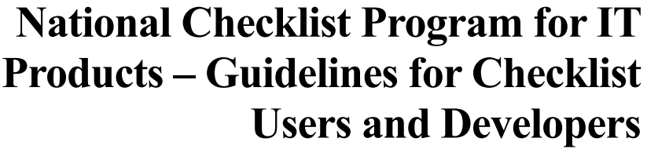
Analyze Existing Controls
Existing controls used to attempt to minimize threats need to be identified
Security controls include:
Management
Operational
Technical processes and procedures
Use checklists of existing controls and interview key organizational staff to solicit information
Illustrates criticality of good communications skills
SJW
Notes:
Before the likelihood of a threat can be specified, any existing controls used by the organization to attempt to minimize threats need to be identified. Security controls include management, operational, and technical processes and procedures that act to reduce the exposure of the organization to some risks by reducing the ability of a threat source to exploit some vulnerabilities. These can be identified by using checklists of existing controls and by interviewing key organizational staff to solicit this information.

Slide 39
Table 14.2
Risk Likelihood
Rating | Likelihood Description | Expanded Definition
1 | Rare | May occur only in exceptional circumstances and may be deemed as “unlucky” or very unlikely
2 | Unlikely | Could occur at some time but not expected given current controls, circumstances, and recent events.
3 | Possible | Might occur at some time but just as likely as not. It may be difficult to control its occurrence due to external influences.
4 | Likely | Will probably occur in some circumstance, and one should not be surprised if it occurred.
5 | Almost Certain | Is expected to occur in most circumstances and certainly sooner or later.
Notes:
Having identified existing controls, the likelihood that each identified threat could occur and cause harm to some asset needs to be specified. The likelihood is typically described qualitatively, using values and descriptions such as those shown in Table 14.2. While the various risk assessment standards all suggest tables similar to these, there is considerable variation in their detail. The selection of the specific descriptions and tables used is determined at the beginning of the risk assessment process when the context is established.
There will very likely be some uncertainty and debate over exactly which rating is most appropriate. This reflects the qualitative nature of the ratings, ambiguity in their precise meaning, and uncertainty over precisely how likely it is that some threat may eventuate. It is important to remember that the goal of this process is to provide guidance to management as to which risks exist and provide enough information to help management decide how to most appropriately respond. Any uncertainty in the selection of ratings should be noted in the discussion on their selection, but ultimately management will make a business decision in response to this information.
The risk analyst takes the descriptive asset and threat/vulnerability details from the preceding steps in this process and, in light of the organization’s overall risk environment and existing controls, decides the appropriate rating. This estimation relates to the likelihood of the specified threat exploiting one or more vulnerabilities to an asset or group of assets, which results in harm to the organization. The specified likelihood needs to be realistic. In particular, a rating of likely or higher suggests that this threat has occurred sometime previously. This means history provides supporting evidence for its specification. If this is not the case, then specifying such a value would need to be justified on the basis of a significantly changed threat environment, a change in the I T system that has weakened its security, or some other rationale for the threat’s anticipated likely occurrence. In contrast, the Unlikely and Rare ratings can be very hard to quantify. They are an indication that the threat is of concern, but whether it could occur is difficult to specify. Typically such threats would only be considered if the consequences to the organization of their occurrence are so severe that they must be considered, even if extremely improbable.

Slide 40
Table 14.3 (1 of 2)
Risk Consequences
Rating | Consequence | Expanded Definition
1 | Insignificant | Generally, a result of a minor security breach in a single area. Impact is likely to last less than several days and requires only minor expenditure to rectify. Usually does not result in any tangible detriment to the organization.
2 | Minor | Result of a security breach in one or two areas. Impact is likely to last less than a week but can be dealt with at the segment or project level without management intervention. Can generally be rectified within project or team resources. Again, does not result in any tangible detriment to the organization but may, in hindsight, show previous lost opportunities or lack of efficiency
3 | Moderate | Limited systemic (and possibly ongoing) security breaches. Impact is likely to last up to two weeks and will generally require management intervention, though should still be able to be dealt with at the project or team level. Will require some ongoing compliance costs to overcome. Customers or the public may be indirectly aware or have limited information about this event.
4 | Major | Ongoing systemic security breach. Impact will likely last 4–8 weeks and require significant management intervention and resources to overcome. Senior management will be required to sustain ongoing direct management for the duration of the incident and compliance costs are expected to be substantial. Customers or the public will be aware of the occurrence of such an event and will be in possession of a range of important facts. Loss of business or organizational outcomes is possible but not expected, especially if this is a once-off.
Notes:
The analyst must then specify the consequence of a specific threat eventuating. Note this is distinct from and not related to the likelihood of the threat occurring. Rather, consequence specification indicates the impact on the organization should the particular threat in question actually eventuate. Even if a threat is regarded as rare or unlikely, if the organization would suffer severe consequence should it occur, then it clearly poses a risk to the organization. Hence, appropriate responses must be considered. A qualitative descriptive value, such as those shown in Table 14.3, is typically used to describe the consequence. As with the likelihood ratings, there is likely to be some uncertainty as to the best rating to use.
This determination should be based upon the judgment of the asset’s owners and the organization’s management, rather than the opinion of the risk analyst. This is in contrast with the likelihood determination. The specified consequence needs to be realistic. It must relate to the impact on the organization as a whole should this specific threat eventuate. It is not just the impact on the affected system. It is possible that a particular system (a server in one location, for example) might be completely destroyed in a fire. However, the impact on the organization could vary from it being a minor inconvenience (the server was in a branch office, and all data were replicated elsewhere) to a major disaster (the server had the sole copy of all customer and financial records for a small business). As with the likelihood ratings, the consequence ratings must be determined knowing the organization’s current practices and arrangements. In particular, the organization’s existing backup, disaster recovery, and contingency planning, or lack thereof, will influence the choice of rating.

Slide 41
Table 14.3 (2 of 2)
Risk Consequences
Rating | Consequence | Expanded Definition
5 | Catastrophic | Major systemic security breach. Impact will last for three months or more and senior management will be required to intervene for the duration of the event to overcome shortcomings. Compliance costs are expected to be very substantial. A loss of customer business or other significant harm to the organization is expected. Substantial public or political debate about and loss of confidence in the organization is likely. Possible criminal or disciplinary action against personnel involved is likely.
6 | Doomsday | Multiple instances of major systemic security breaches. Impact duration cannot be determined, and senior management will be required to place the company under voluntary administration or other form of major restructuring. Criminal proceedings against senior management is expected, and substantial loss of business and failure to meet organizational objectives is unavoidable. Compliance costs are likely to result in annual losses for some years with liquidation of the organization likely.

Slide 42
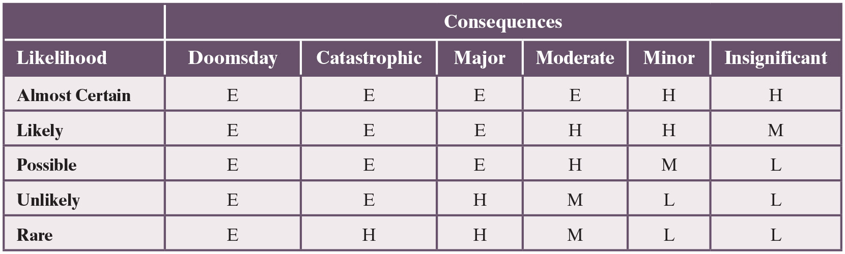
Table 14.4
Risk Level Determination - Combines risk likelihood and consequences to arrive at risk level and Meaning
Risk Level | Description
Extreme (E) | Will require detailed research and management planning at an executive/director level. Ongoing planning and monitoring will be required with regular reviews. Substantial adjustment of controls to manage the risk is expected with costs possibly exceeding original forecasts.
High (H) | Requires management attention, but management and planning can be left to senior project or team leaders. Ongoing planning and monitoring with regular reviews are likely, though adjustment of controls is likely to be met from within existing resources.
Medium (M) | Can be managed by existing specific monitoring and response procedures. Management by employees is suitable with appropriate monitoring and reviews.
Low (L) | Can be managed through routine procedures.
SJW
Notes:
Once the likelihood and consequence of each specific threat have been identified, a final level of risk can be assigned. This is typically determined using a table that maps these values to a risk level, such as those shown in Table 14.4. This table details the risk level assigned to each combination. Such a table provides the qualitative equivalent of performing the ideal risk calculation using quantitative values. It also indicates the interpretation of these assigned levels.
Long Description:
The table consists of 7 columns and 5 rows. The headings of the columns are as follows. Column 1: Likelihood and Consequences. The Consequences column is divided into five sub-columns which are given as follows. Column 1: Doomsday, Column 2: Catastrophic, Column 3: Major, Column 4: Moderate, Column 5: Minor, and Column 6: Insignificant. The row entries are as follows. Row 1: Column 1: Almost Certain. Column 2: E. Column 3: E. Column 4: E. Column 5: E. Column 6: H. Column 7: H. Row 2: Column 1: Likely. Column 2: E. Column 3: E. Column 4: E. Column 5: H. Column 6: H. Column 7: M. Row 3: Column 1: Possible. Column 2: E. Column 3: E. Column 4: E. Column 5: H. Column 6: M. Column 7: L. Row 4: Column 1: Unlikely. Column 2: E. Column 3: E. Column 4: H. Column 5: M. Column 6: L. Column 7: L. Row 5: Column 1: Rare. Column 2: E. Column 3: H. Column 4: H. Column 5: M. Column 6: L. Column 7: L.

Slide 43
Table 14.5
Risk Register
Likelihood X Consequence = Level of Risk
Asset | Threat/ Vulnerability | Existing Controls | Likelihood | Consequence | Level of Risk | Risk Priority
Internet router | Outside hacker attack | Admin password only | Possible | Moderate | High | 1
Destruction of data center | Accidental fire or flood | None (no disaster recovery plan) | Unlikely | Major | High | 2
Accompanied by supporting details of how the various items were determined:
rationale, justification and supporting evidence
Provides senior management with information to make decisions on how to best manage the identified risks
Provides evidence that a risk assessment process has been followed
SJW
Notes:
The results of the risk analysis process should be documented in a risk register. This should include a summary table such that shown in Table 14.5. The risks are usually sorted in decreasing order of level. This would be supported by details of how the various items were determined, including the rationale, justification, and supporting evidence used. The aim of this documentation is to provide senior management with the information needed to make appropriate decisions as how to best manage the identified risks. It also provides evidence that a formal risk assessment process has been followed if needed, and a record of decisions made with the reasons for those decisions.
Once the details of potentially significant risks are determined, management needs to decide whether it needs to take action in response. This would take into account the risk profile of the organization and its willingness to accept a certain level of risk as determined in the initial establishing the context phase of this process. Those items with risk levels below the acceptable level would usually be accepted with no further action required. Those items with risks above this will need to be considered for treatment.

Slide 44
Business Impact
Regulatory impact
Client impact
Market and competition impact
Reputational impact
Financial impact
Source: Approaches and Challenges in Controlling Cyber Risk
– An Industry Perspective by Patrick Duessel
SJW
Notes:
Having identified key assets and the likely threats and vulnerabilities they are exposed to, the next step is to determine the level of risk each of these poses to the organization. The aim is to identify and categorize the risks to assets that threaten the regular operations of the organization. Risk analysis also provides information to management to help managers evaluate these risks and determine how best to treat them. Risk analysis involves first specifying the likelihood of occurrence of each identified threat to an asset in the context of any existing controls. Next, the consequence to the organization is determined should that threat eventuate. Lastly, this information is combined to derive an overall risk rating for each threat. The ideal would be to specify the likelihood as a probability value and the consequence as a monetary cost to the organization should it occur. The resulting risk is then simply given as
Risk = (Probability that threat occurs) x (Cost to organization).
This can be directly equated to the value the threatened asset has for the organization, and, hence, specify what level of expenditure is reasonable to reduce the probability of its occurrence to an acceptable level. Unfortunately, it is often extremely hard to determine accurate probabilities, realistic cost consequences, or both. This is particularly true of intangible assets, such as the loss of confidentiality of a trade secret. Hence, most risk analyses use qualitative, rather than quantitative, ratings for both these items. The goal is then to order the resulting risks to help determine which need to be most urgently treated, rather than to give them an absolute value.

Slide 45
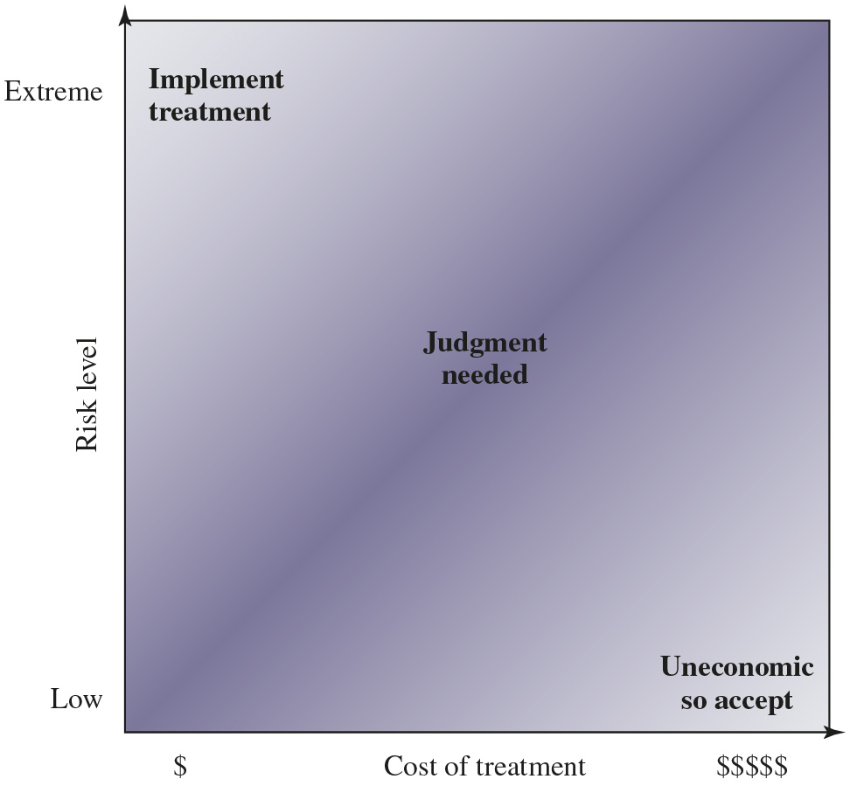
Figure 14.5
Judgment about Risk Treatment
Example: Provide redundancy to protect against earthquake damage
SJW
Notes:
Typically the risks with the higher ratings are those that need action most urgently. However, it is likely that some risks will be easier, faster, and cheaper to address than others. In the example risk register shown in Table 14.5, both risks were rated High. Further investigation reveals that a relatively simple and cheap treatment exists for the first risk by tightening the router configuration to further restrict possible accesses. Treating the second risk requires developing a full disaster recovery plan, a much slower and more costly process. Hence management would take the simple action first to improve the organization’s overall risk profile as quickly as possible. Management may even decide that for business reasons, given an overall view of the organization, some risks with lower levels should be treated ahead of other risks. This is a reflection of both limitations in the risk analysis process in the range of ratings available and their interpretation, and of management’s perspective of the organization as a whole.
Long Description:
The horizontal axis is labeled cost of treatment and the vertical axis is labeled risk level. The left end of the horizontal axis is labeled a dollar symbol and the right end is labeled five dollar symbols. The lower end of the vertical axis is labeled low and the upper end is labeled extreme. The coordinate plane is shaded in purple color, where the region from the lower left corner to the upper right corner are shaded dark and the upper left and lower right corners are light shaded. The upper left and lower right corners are labeled implement treatment and uneconomic so accept. The mid of the coordinate plane is labeled judgement needed.

Slide 46
Risk Treatment Alternatives
Risk acceptance
Choosing to accept a risk level greater than normal for business reasons
Requires risk tolerance to be defined and agreed on
Risk avoidance
Not proceeding with the activity or system that creates this risk
Risk transfer
Sharing responsibility for the risk with a third party
Typically, an insurance company, joint venture or service provider. Example: share cost of constructing $100 - $500M undersea fiber cable
Reduce consequence
Modifying the structure or use of the assets at risk to reduce the impact on the organization should the risk occur
Example: off-site backup of data
Reduce likelihood
Implement suitable controls to lower the chance of the vulnerability being exploited
SJW
Notes:
There are five broad alternatives available to management for treating identified risks:
Risk acceptance: Choosing to accept a risk level greater than normal for business reasons. This is typically due to excessive cost or time needed to treat the risk. Management must then accept responsibility for the consequences to the organization should the risk eventuate.
• Risk avoidance: Not proceeding with the activity or system that creates this risk. This usually results in loss of convenience or ability to perform some function that is useful to the organization. The loss of this capability is traded off against the reduced risk profile.
• Risk transfer: Sharing responsibility for the risk with a third party. This is typically achieved by taking out insurance against the risk occurring, by entering into a contract with another organization, or by using partnership or joint venture structures to share the risks and costs should the threat eventuate.
• Reduce consequence: By modifying the structure or use of the assets at risk to reduce the impact on the organization should the risk occur. This could be achieved by implementing controls to enable the organization to quickly recover should the risk occur. Examples include implementing an off-site backup process, developing a disaster recovery plan, or arranging for data and processing to be replicated over multiple sites.
• Reduce likelihood: By implementing suitable controls to lower the chance of the vulnerability being exploited. These could include technical or administrative controls such as, deploying firewalls and access tokens or procedures such as password complexity and change policies. Such controls aim to improve the security of the asset, making it more difficult for an attack to succeed by reducing the vulnerability of the asset.
If either of the last two options is chosen, then possible treatment controls need to be selected and their cost effectiveness evaluated. There is a wide range of available management, operational, and technical controls that may be used. These would be surveyed to select those that might address the identified threat most effectively and to evaluate the cost to implement against the benefit gained. Management would then choose among the options as to which should be adopted and plan for their implementation. We introduce the range of controls often used and the use of security plans and policies in Chapter 15 and provide further details of some specific control areas in Chapters 16 – 18.

Slide 47
Typical Risk Management Process
Identify risks
Risks present
Assess inherent risk
Likelihood and impact without considering actions to reduce risk
Assess management activities
Responses to identified risks
Determine residual risks
Remaining risk
Determine preliminary, combined risk tolerance
The acceptable level of risk and risk loss impact based on business strategy, environment and risk appetite
Determine or adjust risk response
Respond to risk based on tolerance and potential impact (accept, avoid, transfer, mitigate)
Source: Approaches and Challenges in Controlling Cyber Risk
– An Industry Perspective by Patrick Duessel
SJW
Notes:
There are five broad alternatives available to management for treating identified risks:
Risk acceptance: Choosing to accept a risk level greater than normal for business reasons. This is typically due to excessive cost or time needed to treat the risk. Management must then accept responsibility for the consequences to the organization should the risk eventuate.
• Risk avoidance: Not proceeding with the activity or system that creates this risk. This usually results in loss of convenience or ability to perform some function that is useful to the organization. The loss of this capability is traded off against the reduced risk profile.
• Risk transfer: Sharing responsibility for the risk with a third party. This is typically achieved by taking out insurance against the risk occurring, by entering into a contract with another organization, or by using partnership or joint venture structures to share the risks and costs should the threat eventuate.
• Reduce consequence: By modifying the structure or use of the assets at risk to reduce the impact on the organization should the risk occur. This could be achieved by implementing controls to enable the organization to quickly recover should the risk occur. Examples include implementing an off-site backup process, developing a disaster recovery plan, or arranging for data and processing to be replicated over multiple sites.
• Reduce likelihood: By implementing suitable controls to lower the chance of the vulnerability being exploited. These could include technical or administrative controls such as, deploying firewalls and access tokens or procedures such as password complexity and change policies. Such controls aim to improve the security of the asset, making it more difficult for an attack to succeed by reducing the vulnerability of the asset.
If either of the last two options is chosen, then possible treatment controls need to be selected and their cost effectiveness evaluated. There is a wide range of available management, operational, and technical controls that may be used. These would be surveyed to select those that might address the identified threat most effectively and to evaluate the cost to implement against the benefit gained. Management would then choose among the options as to which should be adopted and plan for their implementation. We introduce the range of controls often used and the use of security plans and policies in Chapter 15 and provide further details of some specific control areas in Chapters 16 – 18.

Slide 48
Risk Assessment of Social Media
A huge threat
http://www.sans.org/reading_room/whitepapers/privacy/risk-assessment-social-media_33940
SJW
Notes:
There are five broad alternatives available to management for treating identified risks:
Risk acceptance: Choosing to accept a risk level greater than normal for business reasons. This is typically due to excessive cost or time needed to treat the risk. Management must then accept responsibility for the consequences to the organization should the risk eventuate.
• Risk avoidance: Not proceeding with the activity or system that creates this risk. This usually results in loss of convenience or ability to perform some function that is useful to the organization. The loss of this capability is traded off against the reduced risk profile.
• Risk transfer: Sharing responsibility for the risk with a third party. This is typically achieved by taking out insurance against the risk occurring, by entering into a contract with another organization, or by using partnership or joint venture structures to share the risks and costs should the threat eventuate.
• Reduce consequence: By modifying the structure or use of the assets at risk to reduce the impact on the organization should the risk occur. This could be achieved by implementing controls to enable the organization to quickly recover should the risk occur. Examples include implementing an off-site backup process, developing a disaster recovery plan, or arranging for data and processing to be replicated over multiple sites.
• Reduce likelihood: By implementing suitable controls to lower the chance of the vulnerability being exploited. These could include technical or administrative controls such as, deploying firewalls and access tokens or procedures such as password complexity and change policies. Such controls aim to improve the security of the asset, making it more difficult for an attack to succeed by reducing the vulnerability of the asset.
If either of the last two options is chosen, then possible treatment controls need to be selected and their cost effectiveness evaluated. There is a wide range of available management, operational, and technical controls that may be used. These would be surveyed to select those that might address the identified threat most effectively and to evaluate the cost to implement against the benefit gained. Management would then choose among the options as to which should be adopted and plan for their implementation. We introduce the range of controls often used and the use of security plans and policies in Chapter 15 and provide further details of some specific control areas in Chapters 16 – 18.

Slide 49
Case Study: Silver Star Mines
Fictional operation of global mining company
Large I T infrastructure
Both common and specific software
Some directly relates to health and safety
Formerly isolated systems now networked
Decided on combined approach
Mining industry less risky end of spectrum
Subject to legal/regulatory requirements
Management accepts moderate or low risk
Notes:
A case study involving the operations of a fictional company Silver Star Mines illustrates this risk assessment process. Silver Star Mines is the local operations of a large global mining company. It has a large I T infrastructure used by numerous business areas. Its network includes a variety of servers, executing a range of application software typical of organizations of its size. It also uses applications that are far less common, some of which directly relate to the health and safety of those working in the mine. Many of these systems used to be isolated with no network connections among them. In recent years, they have been connected together and connected to the company’s intranet to provide better management capabilities. However, this means they are now potentially accessible from the Internet, which has greatly increased the risks to these systems.
A security analyst was contracted to provide an initial review of the company’s risk profile and to recommend further action for improvement. Following initial discussion with company management, a decision was made to adopt a combined approach to security management. This requires the adoption of suitable baselines standards by the company’s I T support group for their systems. Meanwhile, the analyst was asked to conduct a preliminary formal assessment of the key I T systems to identify those most at risk, which management could then consider for treatment.
The first step was to determine the context for the risk assessment. Being in the mining industry sector places the company at the less risky end of the spectrum and consequently less likely to be specifically targeted. Silver Star Mines is part of a large organization and hence is subject to legal requirements for occupational health and safety and is answerable to its shareholders. Thus management decided that it wished to accept only moderate or lower risks in general. The boundaries for this risk assessment were specified to include only the systems under the direct control of the Silver Star Mines operations. This excluded the wider company intranet, its central servers, and its Internet gateway. This assessment is sponsored by Silver Star’s I T and engineering managers with results to be reported to the company board. The assessment would use the process and ratings described in this chapter.

Slide 50
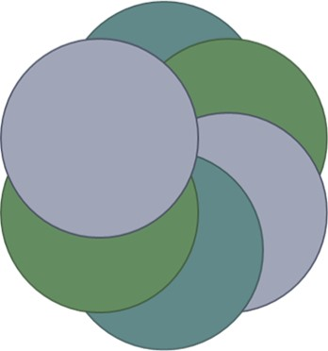
Assets
Reliability and integrity of S C A D A nodes and net
Availability, integrity and confidentiality of mail services
Integrity of stored file and database information
Availability, integrity of maintenance/production system
Availability, integrity of financial system
Availability, integrity of procurement system
Notes:
Next, the key assets had to be identified. The analyst conducted interviews with key I T and engineering managers in the company. A number of the engineering managers emphasized how important the reliability of the S C A D A network and nodes were to the company. They control and monitor the core mining operations of the company and enable it to operate safely and efficiently and, most crucially, to generate revenue. Some of these systems also maintain the records required by law, which are regularly inspected by the government agencies responsible for the mining industry. Any failure to create, preserve, and produce on demand these records would expose the company to fines and other legal sanctions. Hence, these systems were listed as the first key asset.
A number of the I T managers indicated that a large amount of critical data was stored on various file servers either in individual files or in databases. They identified the importance of the integrity of these data to the company. Some of these data were generated automatically by applications. Other data were created by employees using common office applications. Some of this needed be available for audits by government agencies. There were also data on production and operational results, contracts and tendering, personnel, application backups, operational and capital expenditure, mine survey and planning, and exploratory drilling. Collectively, the integrity of stored data was identified as the second key asset.
These managers also indicated that three key systems—the Financial, Procurement, and Maintenance/Production servers—were critical to the effective operation of core business areas. Any compromise in the availability or integrity of these systems would impact the company’s ability to operate effectively. Hence each of these were identified as a key asset.

Slide 51
Table 14.6
Silver Star Mines—Risk Register
Asset | Threat/ Vulnerability | Existing Controls | Likelihood | Consequence | Level of Risk | Risk Priority
Reliability and integrity of the SCADA nodes and network | Unauthorized modification of control system | Layered firewalls and servers | Rare | Major | High | 1
Integrity of stored file and database information | Corruption, theft, and loss of info | Firewall, policies | Possible | Major | Extreme | 2
Availability and integrity of financial system | Attacks/errors affecting system | Firewall, policies | Possible | Moderate | High | 3
Availability and integrity of procurement system | Attacks/errors affecting system | Firewall, policies | Possible | Moderate | High | 4
Availability and integrity of maintenance/ production system | Attacks/errors affecting system | Firewall, policies | Possible | Minor | Medium | 5
Availability, integrity, and confidentiality of mail services | Attacks/errors affecting system | Firewall, ext mail gateway | Almost Certain | Minor | High | 6
Notes:
Lastly, the analyst identified e-mail as a key asset as a result of interviews with all business areas of the company. The use of e-mail as a business tool cuts across all business areas. Around 60% of all correspondence is in the form of e-mail, which is used to communicate daily with head office, other business units, suppliers, and contractors as well as to conduct a large amount of internal correspondence. E-mail is given greater importance than usual due to the remote location of the company. Hence the collective availability, integrity, and confidentiality of mail services was listed as a key asset.
This list of key assets is seen in the first column of Table 14.6, which is the risk register created at the conclusion of this risk assessment process.
Having determined the list of key assets, the analyst needed to identify significant threats to these assets and to specify the likelihood and consequence values. The major concern with the S C A D A asset is unauthorized compromise of nodes by an external source. These systems were originally designed for use on physically isolated and trusted networks and, hence, were not hardened against external attack to the degree that modern systems can be. Often these systems are running older releases of operating systems with known insecurities. Many of these systems have not been patched or upgraded because the key applications they run have not been updated or validated to run on newer O S versions. More recently, the S C A D A networks have been connected to the company’s intranet to provide improved management and monitoring capabilities. Recognizing that the S C A D A nodes are very likely insecure, these connections are isolated from the company intranet by additional firewall and proxy server systems. Any external attack would have to break through the outer company firewall, the S C A D A network firewall, and these proxy servers in order to attack the S C A D A nodes. This would require a series of security breaches. Nonetheless, given that the various computer crime surveys suggest that externally sourced attacks are increasing and known cases of attacks on S C A D A networks exist, the analyst concluded that, while an attack was very unlikely, it could still occur. Thus a likelihood rating of Rare was chosen. The consequence of the S C A D A network suffering a successful attack was discussed with the mining engineers. They indicated that interference with the control system could have serious consequences as it could affect the safety of personnel in the mine. Ventilation, bulk cooling, fire protection, hoisting of personnel and materials, and underground fill systems are possible areas whose compromise could lead to a fatality. Environmental damage could result from the spillage of highly toxic materials into nearby waterways. Additionally, the financial impact could be significant as downtime is measured in tens of millions of dollars per hour. There is even a possibility that Silver Star’s mining license might be suspended if the company was found to have breached its legal requirements. A consequence rating of Major was selected. This results in a risk level of High.
The second asset concerned the integrity of stored information. The analyst noted numerous reports of unauthorized use of file systems and databases in recent computer crime surveys. These assets could be compromised by both internal and external sources. These can be either the result of intentional malicious or fraudulent acts or the unintentional deletion, modification, or disclosure of information. All indications are that such database security breaches are increasing and that access to such data is a primary goal of intruders. These systems are located on the company intranet and, hence, are shielded by the company’s outer firewall from much external access. However, should that firewall be compromised or an attacker gain indirect access using infected internal systems, compromise of the data was possible. With respect to internal use, the company had policies on the input and handling of a range of data, especially that required for audit purposes. The company also had policies on the backup of data from servers. However, the large number of systems used to create and store this data, both desktop and server, meant that overall compliance with these policies was unknown. Hence a likelihood rating of Possible was chosen. Discussions with some of the company’s IT managers revealed that some of this information is confidential and may cause financial harm if disclosed to others. There also may be substantial financial costs involved with recovering data and other activities subsequent to a breach. There is also the possibility of serious legal consequences if personal information was disclosed or if the results of statutory tests and process information were lost. Hence a consequence rating of Major was selected. This results in a risk level of Extreme.
The availability or integrity of the key Financial, Procurement, and Maintenance/Production systems could be compromised by any form of attack on the operating system or applications they use. Although their location on the company intranet does provide some protection, due to the nature of the company structure a number of these systems have not been patched or maintained for some time. This means at least some of the systems would be vulnerable to a range of network attacks if accessible. Any failure of the company’s outer firewall to block any such attack could very likely result in compromise of some systems by automated attack scans. These are known to occur very quickly, with a number of reports indicating that unpatched systems were compromised in less than 15 minutes after network connection. Hence a likelihood of Possible was specified. Discussions with management indicated that the degree of harm would be proportional to extent and duration of the attack. In most cases a rebuild of at least a portion of the system would be required at considerable expense. False orders being issued to suppliers or the inability to issue orders would have a negative impact on the company’s reputation and could cause confusion and possible plant shutdowns. Not being able to process personnel time sheets and utilize electronic funds transfer and unauthorized transfer of money would also affect the company’s reputation and possibly result in a financial loss. The company indicated that the Maintenance/Production system’s harm rating should be a little lower due the ability of the plant to continue to operate despite some compromise of the system. It would, however, have a detrimental impact on the efficiency of operations. Consequence ratings of Moderate and Minor, respectively, were selected, resulting in risk levels of High or Medium.
The last asset is the availability, integrity, and confidentiality of mail services. Without an effective e-mail system, the company will operate with less efficiency. A number of organizations have suffered failure of their e-mail systems as a result of mass e-mailed worms in past years. New exploits transferred using e-mail are reported. Those exploiting vulnerabilities in common applications are of major concern. The heavy use of e-mail by the company, including the constant exchange and opening of e-mail attachments by employees, means the chance of compromise, especially by a zero-day exploit to a common document type, is very high. While the company does filter mail in its Internet gateway, there is a high probability that a zero-day exploit would not be caught. A denial of service attack against the mail gateway is very hard to defend against. Hence a likelihood rating of Almost Certain was selected in recognition of the wide range of possible attacks and the high chance that one will occur sooner rather than later. Discussions with management indicated that while other possible modes of communication exist, they do not allow for transmission of electronic documents. The ability to obtain electronic quotes is a requirement that must be met to place an order in the purchasing system. Reports and other communications are regularly sent via this e-mail, and any inability to send or receive such reports might affect the company’s reputation. There would also be financial costs and time needed to rebuild the e-mail system following a serious compromise. Because compromise would not have a large impact, a consequence rating of Minor was selected. This results in a risk level of High.
The information was summarized and presented to management. All of the resulting risk levels are above the acceptable minimum management specified as tolerable. Hence treatment is required. Even though the second asset listed had the highest level of risk, management decided that the risk to the SCADA network was unacceptable if there was any possibility of death however remote. Additionally, the management decided that the government regulator would not look favorably upon a company that failed to rate highly the importance of a potential fatality. Consequently, the management decided to specify the risk to the SCADA as the highest priority for treatment. The risk to the integrity of stored information was next. The management also decided to place the risk to the e-mail systems last, behind the lower risk to the Maintenance/Production system, in part because its compromise would not affect the output of the mining and processing units and also because treatment would involve the company’s mail gateway, which was outside the management’s control.
The final result of this risk assessment process is shown in Table 14.6, the resulting overall risk register table. It shows the identified assets with the threats to them, and the assigned ratings and priority. This information would then influence the selection of suitable treatments. Management decided the first five risks should be treated by implementing suitable controls, which would reduce either the likelihood or the consequence should these risks occur. This process is discussed in the next chapter. None of these risks could be accepted or avoided. Responsibility for the final risk to the e-mail system was found to be primarily with the parent company’s IT group, which manages the external mail gateway. Hence the risk is shared with that group.

Slide 52
Summary
I T security management
Organizational context and security policy
Security risk assessment
Baseline approach
Informal approach
Detailed risk analysis
Combined approach
Detailed security risk analysis
Context and system characterization
Identification of threats/risks/vulnerabilities
Analyze risks
Evaluate risks
Risk treatment
Case study: Silver Star Mines
Notes:
Chapter 14 summary.

Slide 53

Copyright
This work is protected by United States copyright laws and is provided solely for the use of instructors in teaching their courses and assessing student learning. Dissemination or sale of any part of this work (including on the World Wide Web) will destroy the integrity of the work and is not permitted. The work and materials from it should never be made available to students except by instructors using the accompanying text in their classes. All recipients of this work are expected to abide by these restrictions and to honor the intended pedagogical purposes and the needs of other instructors who rely on these materials.

